Slide 1


Nursery Curriculum Plan: Autumn 2026
Me and My Classroom
The Big Question: What makes you special?

Slide 2
Nursery Curriculum Plan: Autumn 2026
The aim of Oldway Primary School is to provide opportunities for children to develop as independent, confident and successful learners, with high aspirations and the skills to make a positive contribution to their community.
We aim to provide a curriculum which is enriching and challenging, where children experience the opportunity to learn in a wide range of contexts with meaningful outcomes. The curriculum has been designed so that it:
supports pupils' personal development;
develops a love of learning;
prepares pupils for work and lifelong learning;
develops children as global citizens.

Slide 3

Within our happy and nurturing setting, we provide high quality learning opportunities where children can thrive across all areas of the Early Years curriculum. Our provision encompasses child focused interests and ideas with well thought-out resources to enhance and inspire their development. The curriculum is designed to recognise children’s prior learning from previous settings and their experiences at home. We respect that children have different starting points and we strive to provide a nurturing environment for all that has a strong and excellent partnerships with our children’s families. Partnership and Communication is important to us and we greatly value the relationship that we develop with parents and the community throughout these vital years so that children feel valued, safe and have a sense of belonging. It is our motto to ensure we leave no stone unturned to ensure all children have the very best start to their education at Oldway.
All staff are committed to ensuring that the learning foundations laid down within the early years are solid and secure so that your child will continue to flourish and become lifelong learners. We provide a range of child-led, hands-on learning opportunities where the ability to learn is underpinned by the teaching of basic skills, knowledge, concepts and values. As such we provide many first-hand rich experiences to underpin the children’s knowledge, with the aim of broadening their understanding of the world around them.
We believe that children’s first experiences of school should be happy and positive, enabling us to develop a lifelong love of learning. We provide an environment which will enable children to trust in themselves and in their peers, building resilience, ambition and integrity.

Slide 4
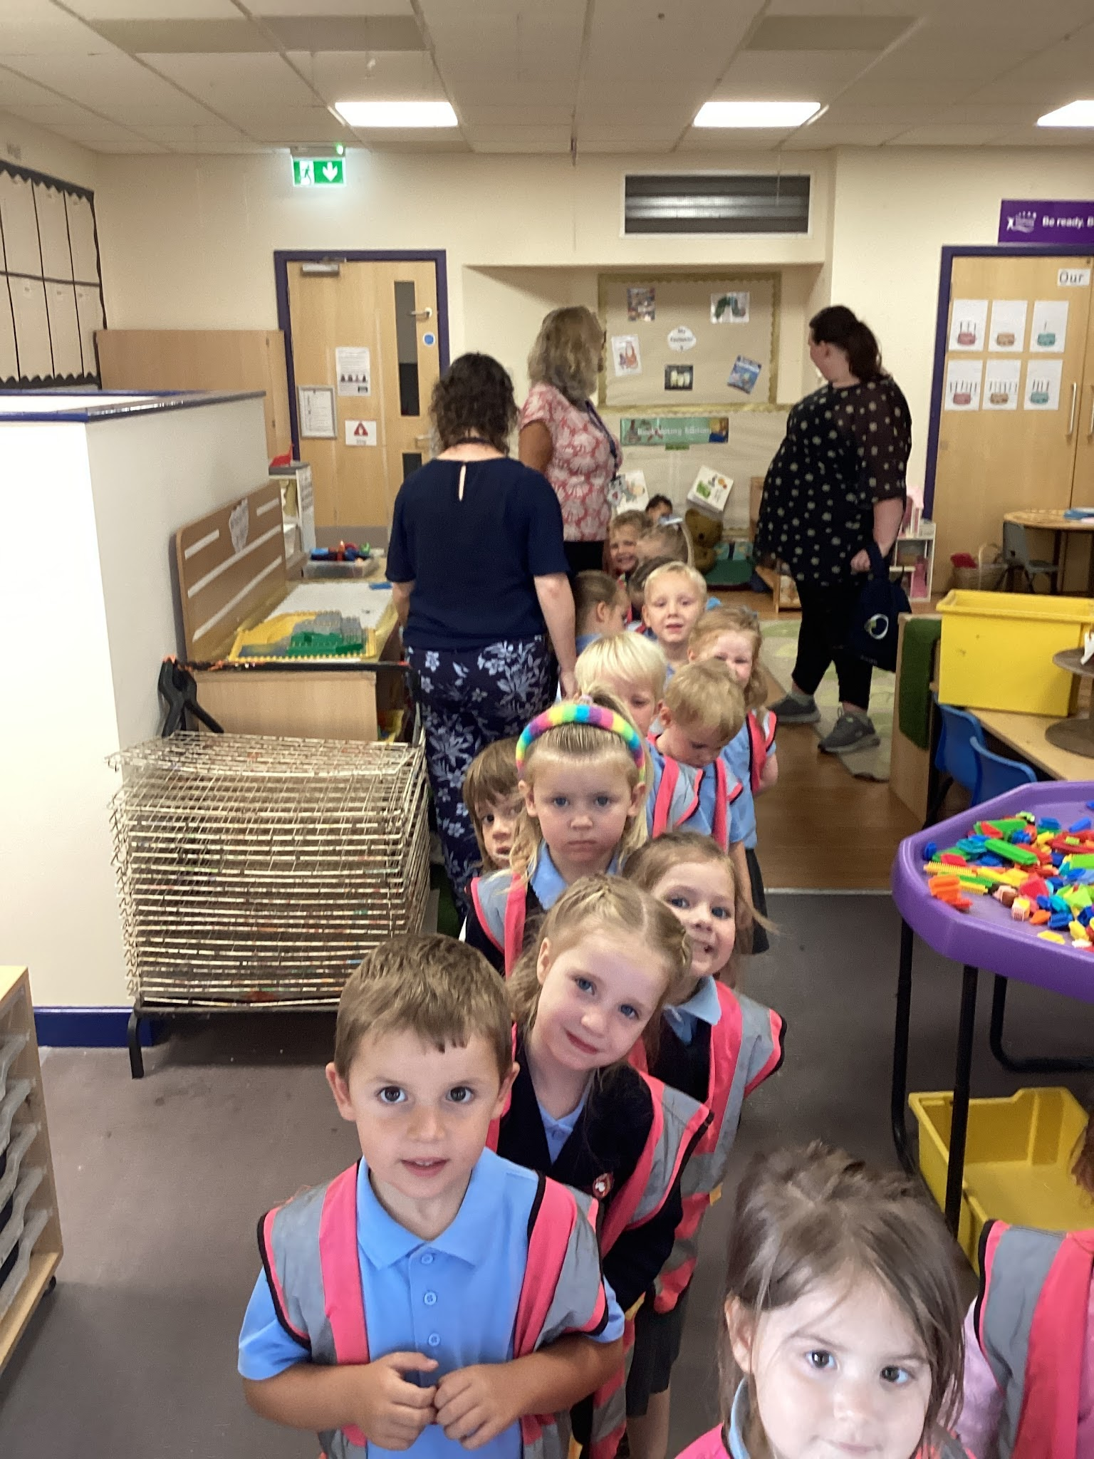
Nursery: Autumn 2026
The first half term in Nursery is all about supporting children to feel secure and happy in their new surroundings. A main focus will be given towards supporting children to develop in confidence and self assurance while making new friendships, sharing and taking turns with others. It will equip them with skills to share their own experiences and also learn about the differences of others. Intertwined through the seven areas of learning, this experience will inspire a deep curiosity and enable them, to communicate, play and flourish with others. This in turn will help lay down the fundamental foundations of a lifelong love of learning.

Slide 5
Curriculum Questions
We are special
Personal, Social and Emotional | Communication and Language | Physical development | Understanding of the World | Expressive arts and design
Who or what is special to you? Who is special to you at home? Does anybody look like you? Do you like the same things as your friends? What makes a good friend? | How do you feel today? Can you think of another word for happy? How do we ask politely? Can you describe your favourite… How can you show you are a good listener? | Can you turn the page? Can you balance on one leg? Can you use your scissors to cut the paper? How do we hold a pencil? | What does your home look like? What places can you name that are near to the school? What places are special to people in our community? What is the same/ different about us? | What is your favourite song/rhyme? Can you act out how the colour monster is feeling? Can you build/make something you are proud of? What do we do with our face if we are happy/ sad/ angry etc?

Slide 6
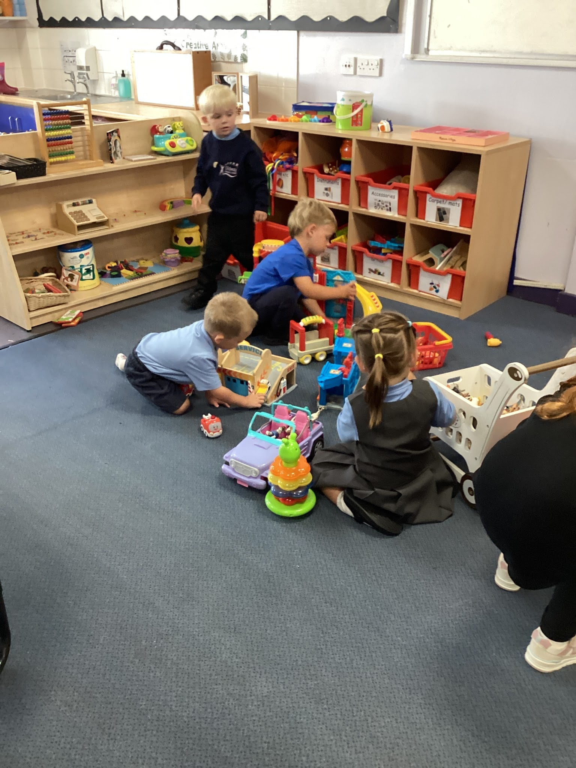
Nursery: Autumn 1 2026
Prime Area: Communication and Language
This half term, we shall support children to:
2 year olds
Respond to their name
Use gestures, sounds and single words to communicate their needs
Recognise familiar people and objects
Begin to notice and play with other children
Follow simple one step instructions
3 and 4 year olds
Use everyday words to talk about the people that they know
Follow simple instructions with visuals
Listen and respond to adults and peers
Settle into class with support
Make friends with their peers and interact with others
Respond to their name and change activity when encouraged to do so

Slide 7
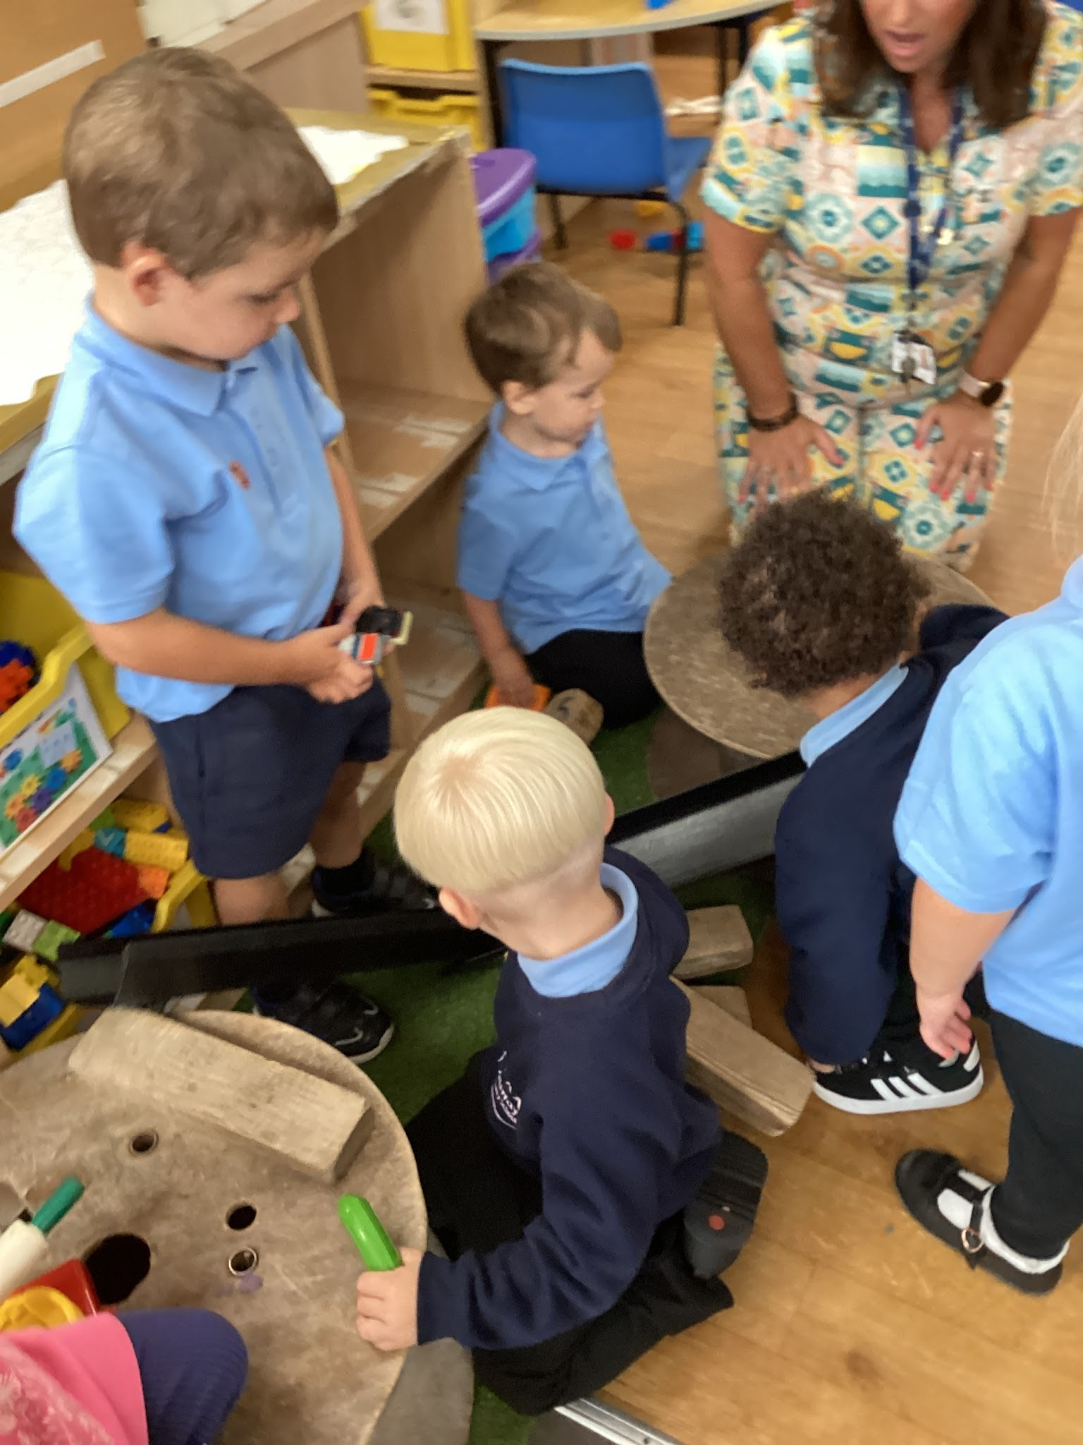
Nursery: Autumn 1 2026
Prime Area: Personal, Social and Emotional Development
This half term, we shall support children to understand how to be healthy throughout the EYFS curriculum by helping them to:
Understand how it feels to belong and that we are similar and different to each other
Understand how feeling happy and sad can be expressed and learn how to consider other people’s feelings
Use kind hands and understand that it is good to be kind to others
Start to understand children’s rights and this means that we should all be allowed to learn and play
Learn and understand what being responsible means

Slide 8
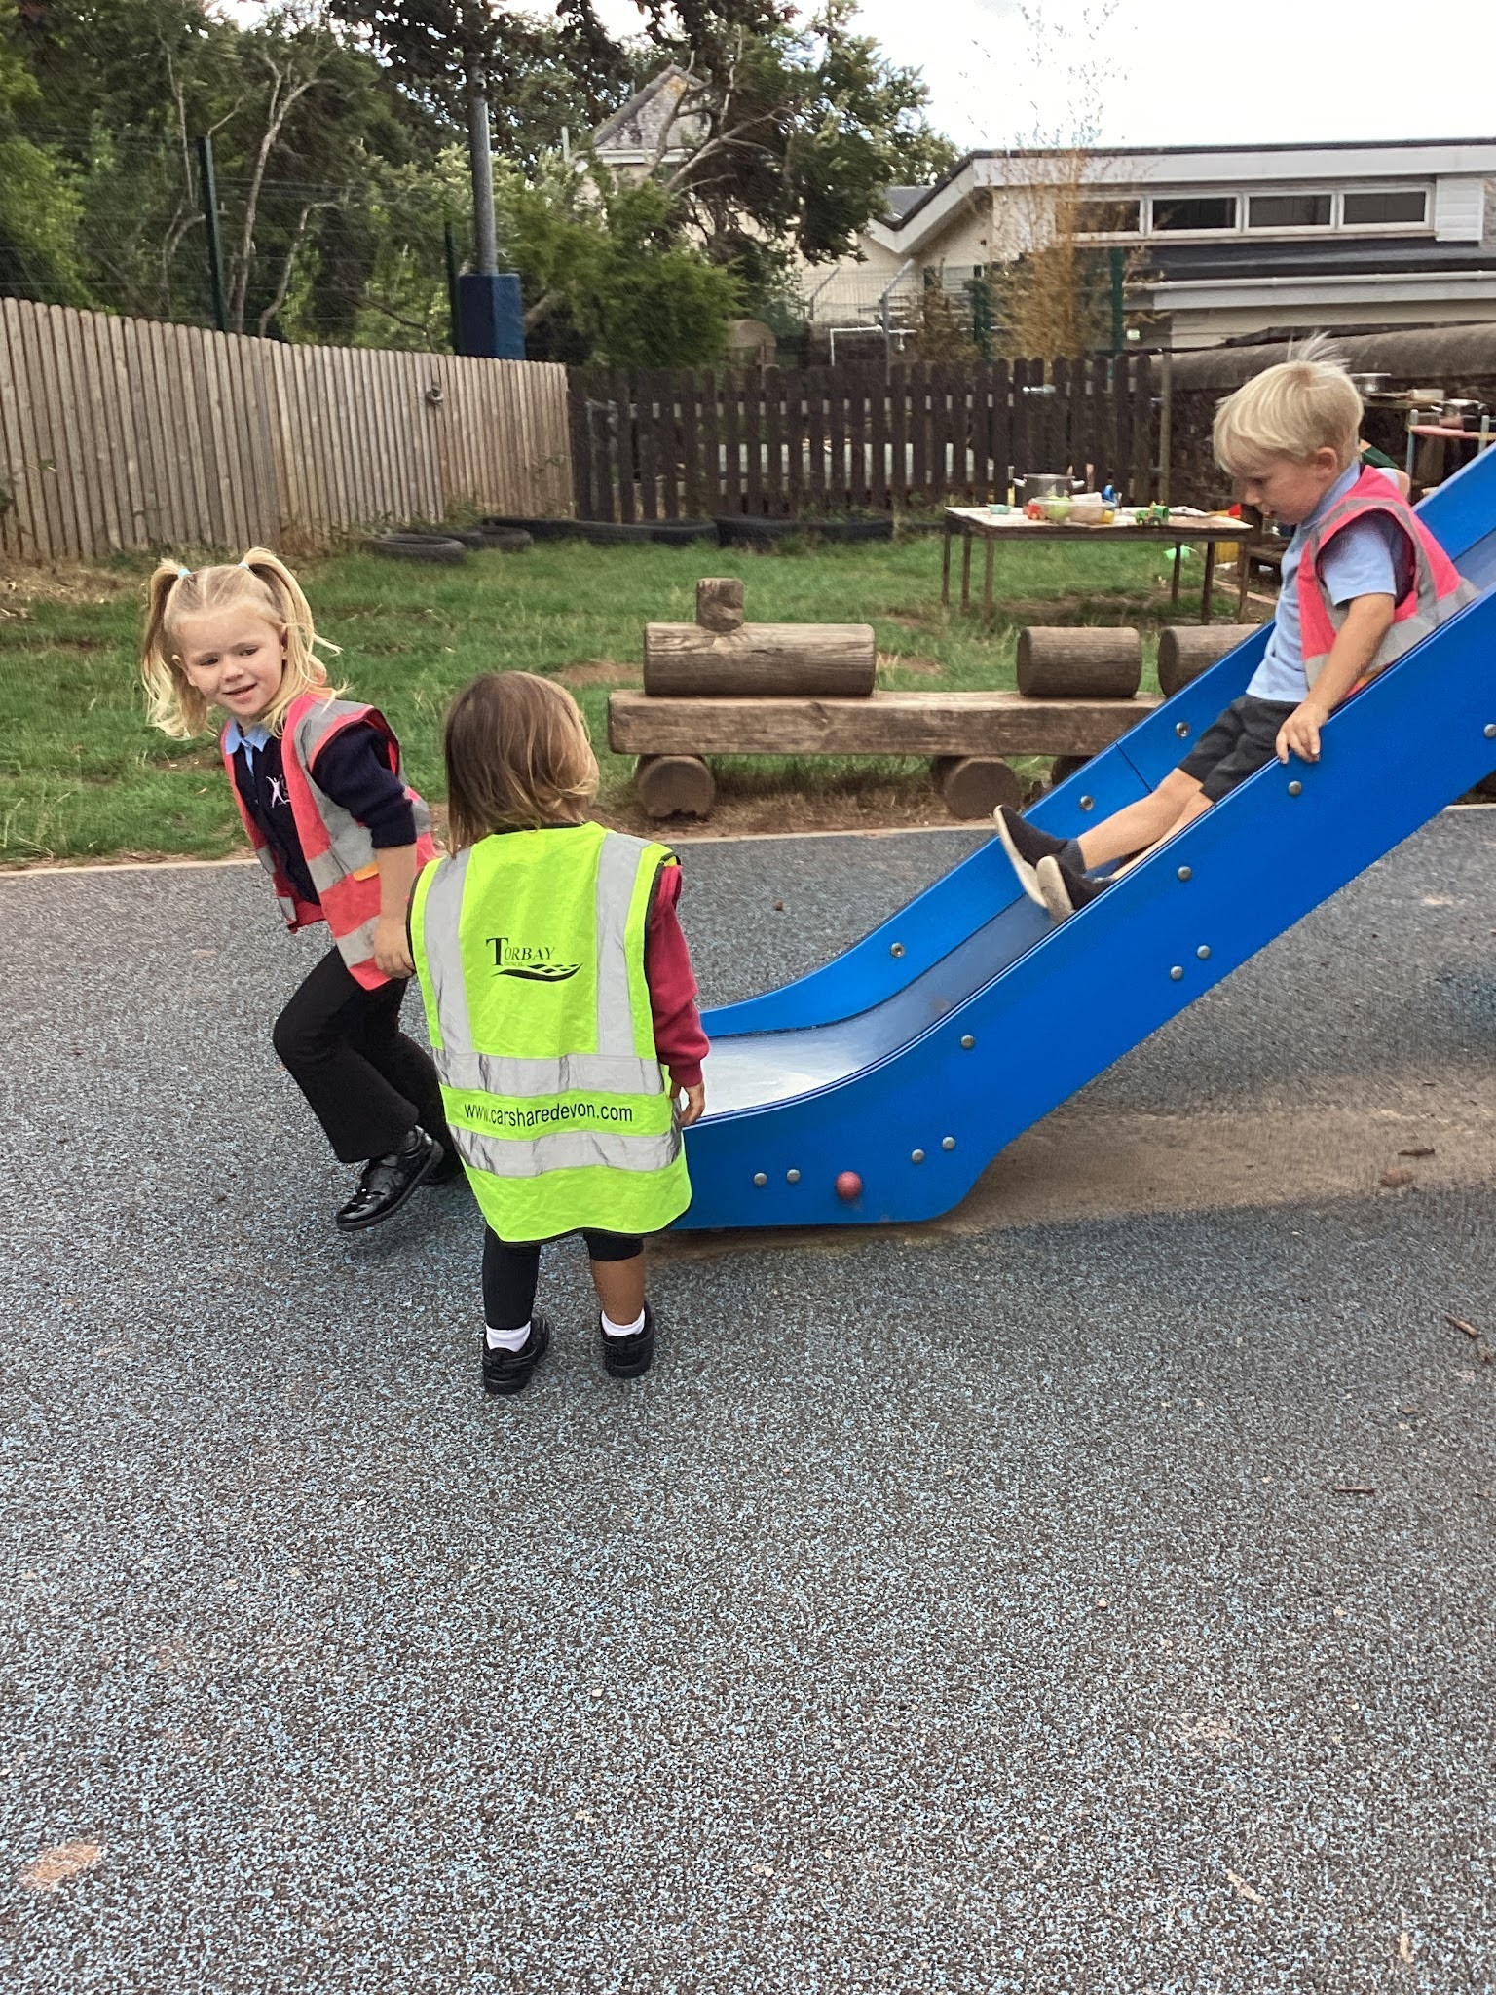
Nursery: Autumn 1 2026
Prime Area: Physical Development
This half term, our provision will ensure children can access spaces and resources that provide varying confidence levels, skills and needs to support a broad range of abilities. We will focus on:
Developing their balance and coordination
Using one-handed tools and equipment.
Holding a pencil to make marks
Turning pages in a book
Drawing lines and circle
Manipulating objects
Making marks using chunky pencils and chalks
Explore scissors with adult support
Negotiating space
Move confidently around familiar space

Slide 9
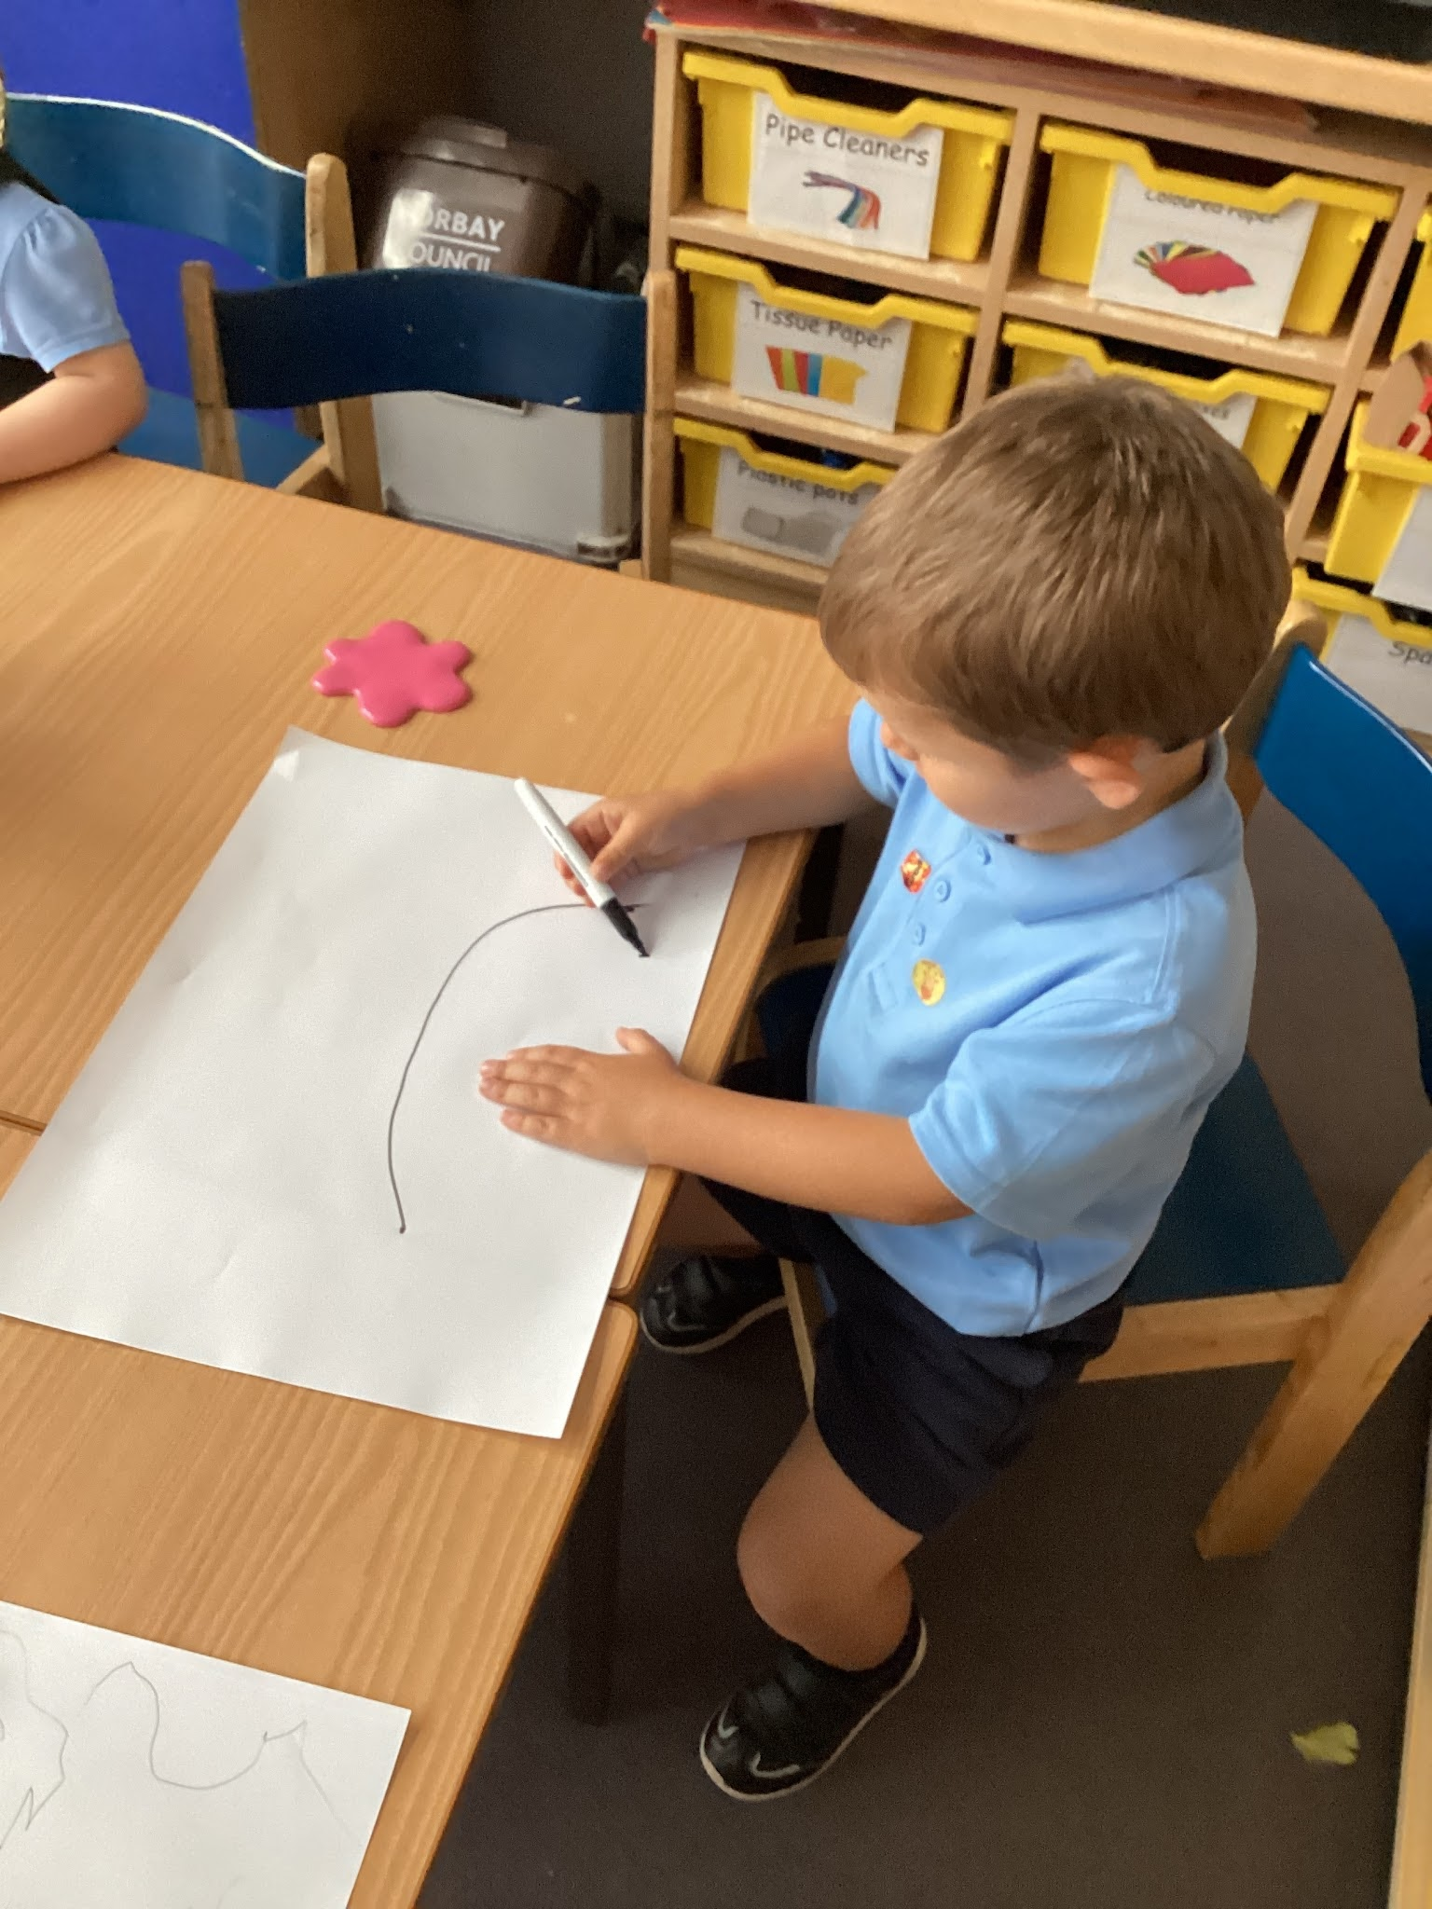
Nursery: Autumn 1 2026
Specific Area: Literacy
This half term, we will be reading the story ‘Owl Babies’ by Martin Waddell. The children will have opportunities to:
2 year olds:
Enjoy listening to songs and stories
Hold books and explore them
Point at pictures
Randomly scribble
Explore mark making
3 and 4 year olds:
Join in with rhythm of well known rhymes and songs
Show a preference for a book or a song
Make marks with interest
Make intentional lines and circles
Begin early symbolic drawing
I c

Slide 10


English- Texts
Supporting texts:
10 little fingers and 10 little toes by Mem Fox
The story celebrates babies born in different places and circumstances all over the world.
Main text:
Owl Babies
By Martin Waddell
Owl Babies by Martin Waddell is a comforting picture book about three young owlets who wake up one night to find their mother missing and bravely wait for her return.

Slide 11




Other supportive texts
Stories and information texts are used as a strong vehicle to support children’s learning throughout all the curriculum in EYFS.

Slide 12
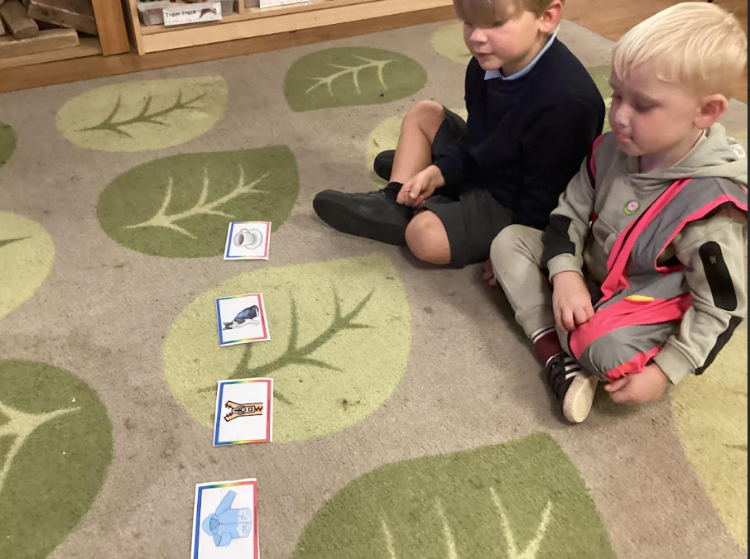
Early Reading
As soon as children start in Nursery we will be focusing on all of the skills needed for children to start learning their phonics sounds. We will be developing children’s listening skills, building children’s awareness of sounds and expose to children to a wide range of vocabulary ready for them to build a foundation for reading.
Ways to support your child in their first term:
Segment and blend words during everyday tasks. E.g.: Do up your z-i-p.
Singing lots of songs that include rhyming patterns
Exploring different sounds made from instruments or even your own voices
Go on listening walks and see what environmental sounds they can hear (ie birds)

Slide 13
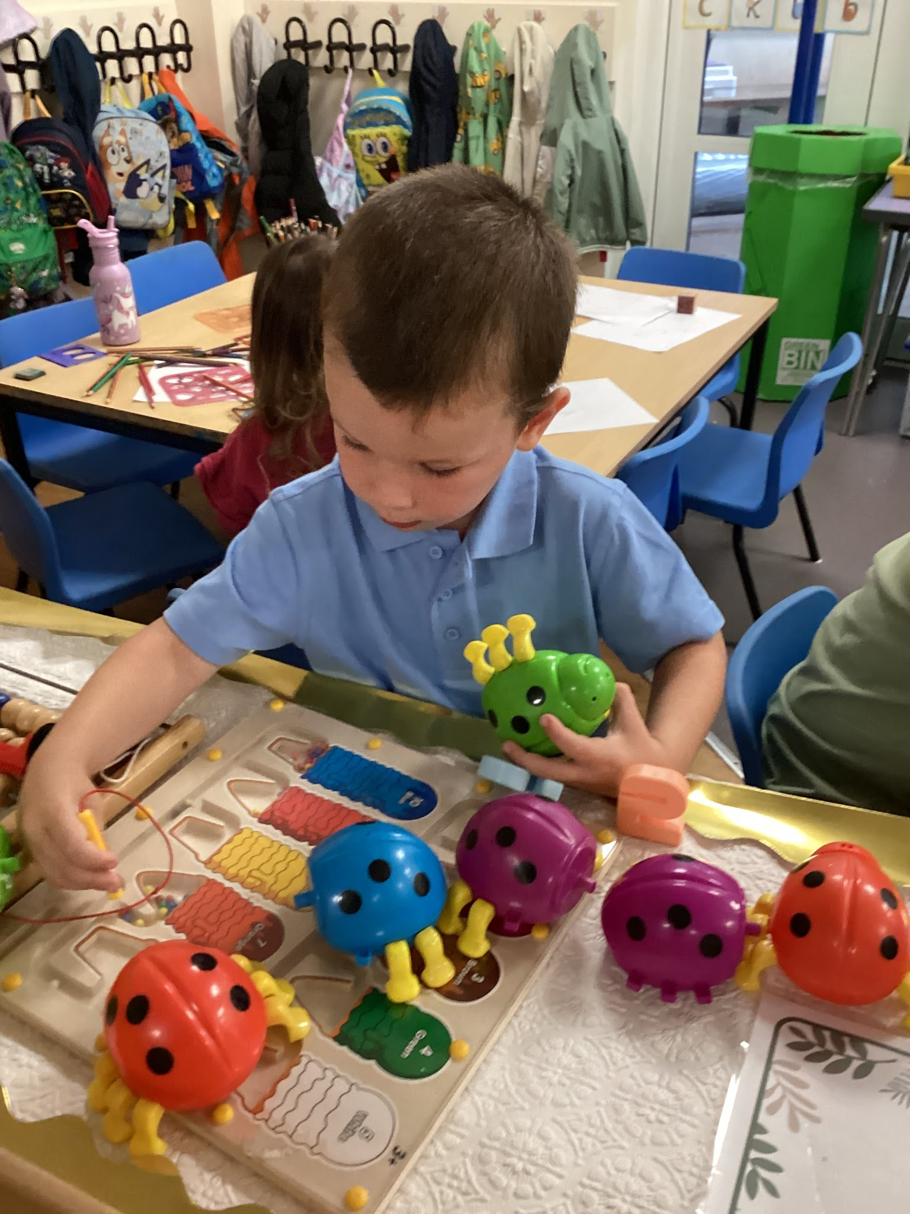
Nursery: Autumn 1 2026
Specific Area: Maths
This term the children will experience maths through whole class and guided sessions, stories, class routines and enhanced provision in their play. Focus will be given to the following areas:
Identifying a range of colours
Matching a variety of resources and equipment such as shapes, towers and number shapes
Sorting objects based on colour, size and shape
Showing interest in number rhymes
Reciting some number names in order
Explore objects through transporting, filling and emptying
Use language such as big, small and lots
Noticing simple patterns

Slide 14
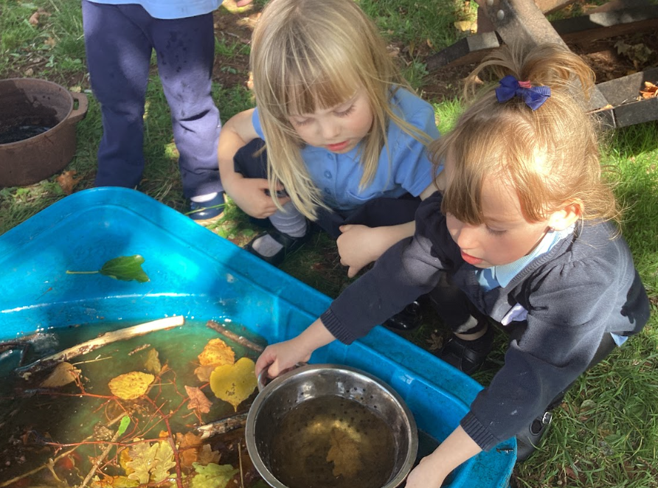
Nursery: Autumn 1 2026
Specific area: Understanding of the World
Within this area of learning, the children will have opportunities to:
2 year olds:
Noticing familiar people
Talk about people special to them
Explore the classroom and outdoor environments
Talk about their home and familiar places
Explore light, dark and shadows
Notice changes in the world around them
Explore seasonal changes
3 and 4 year olds:
Talk about family members and people who are special to them
Share experiences and memories
Follow simple treasure hunts
Explore seasonal changes
Explore materials using their senses
Begin to recognise differences between real events and stories

Slide 15
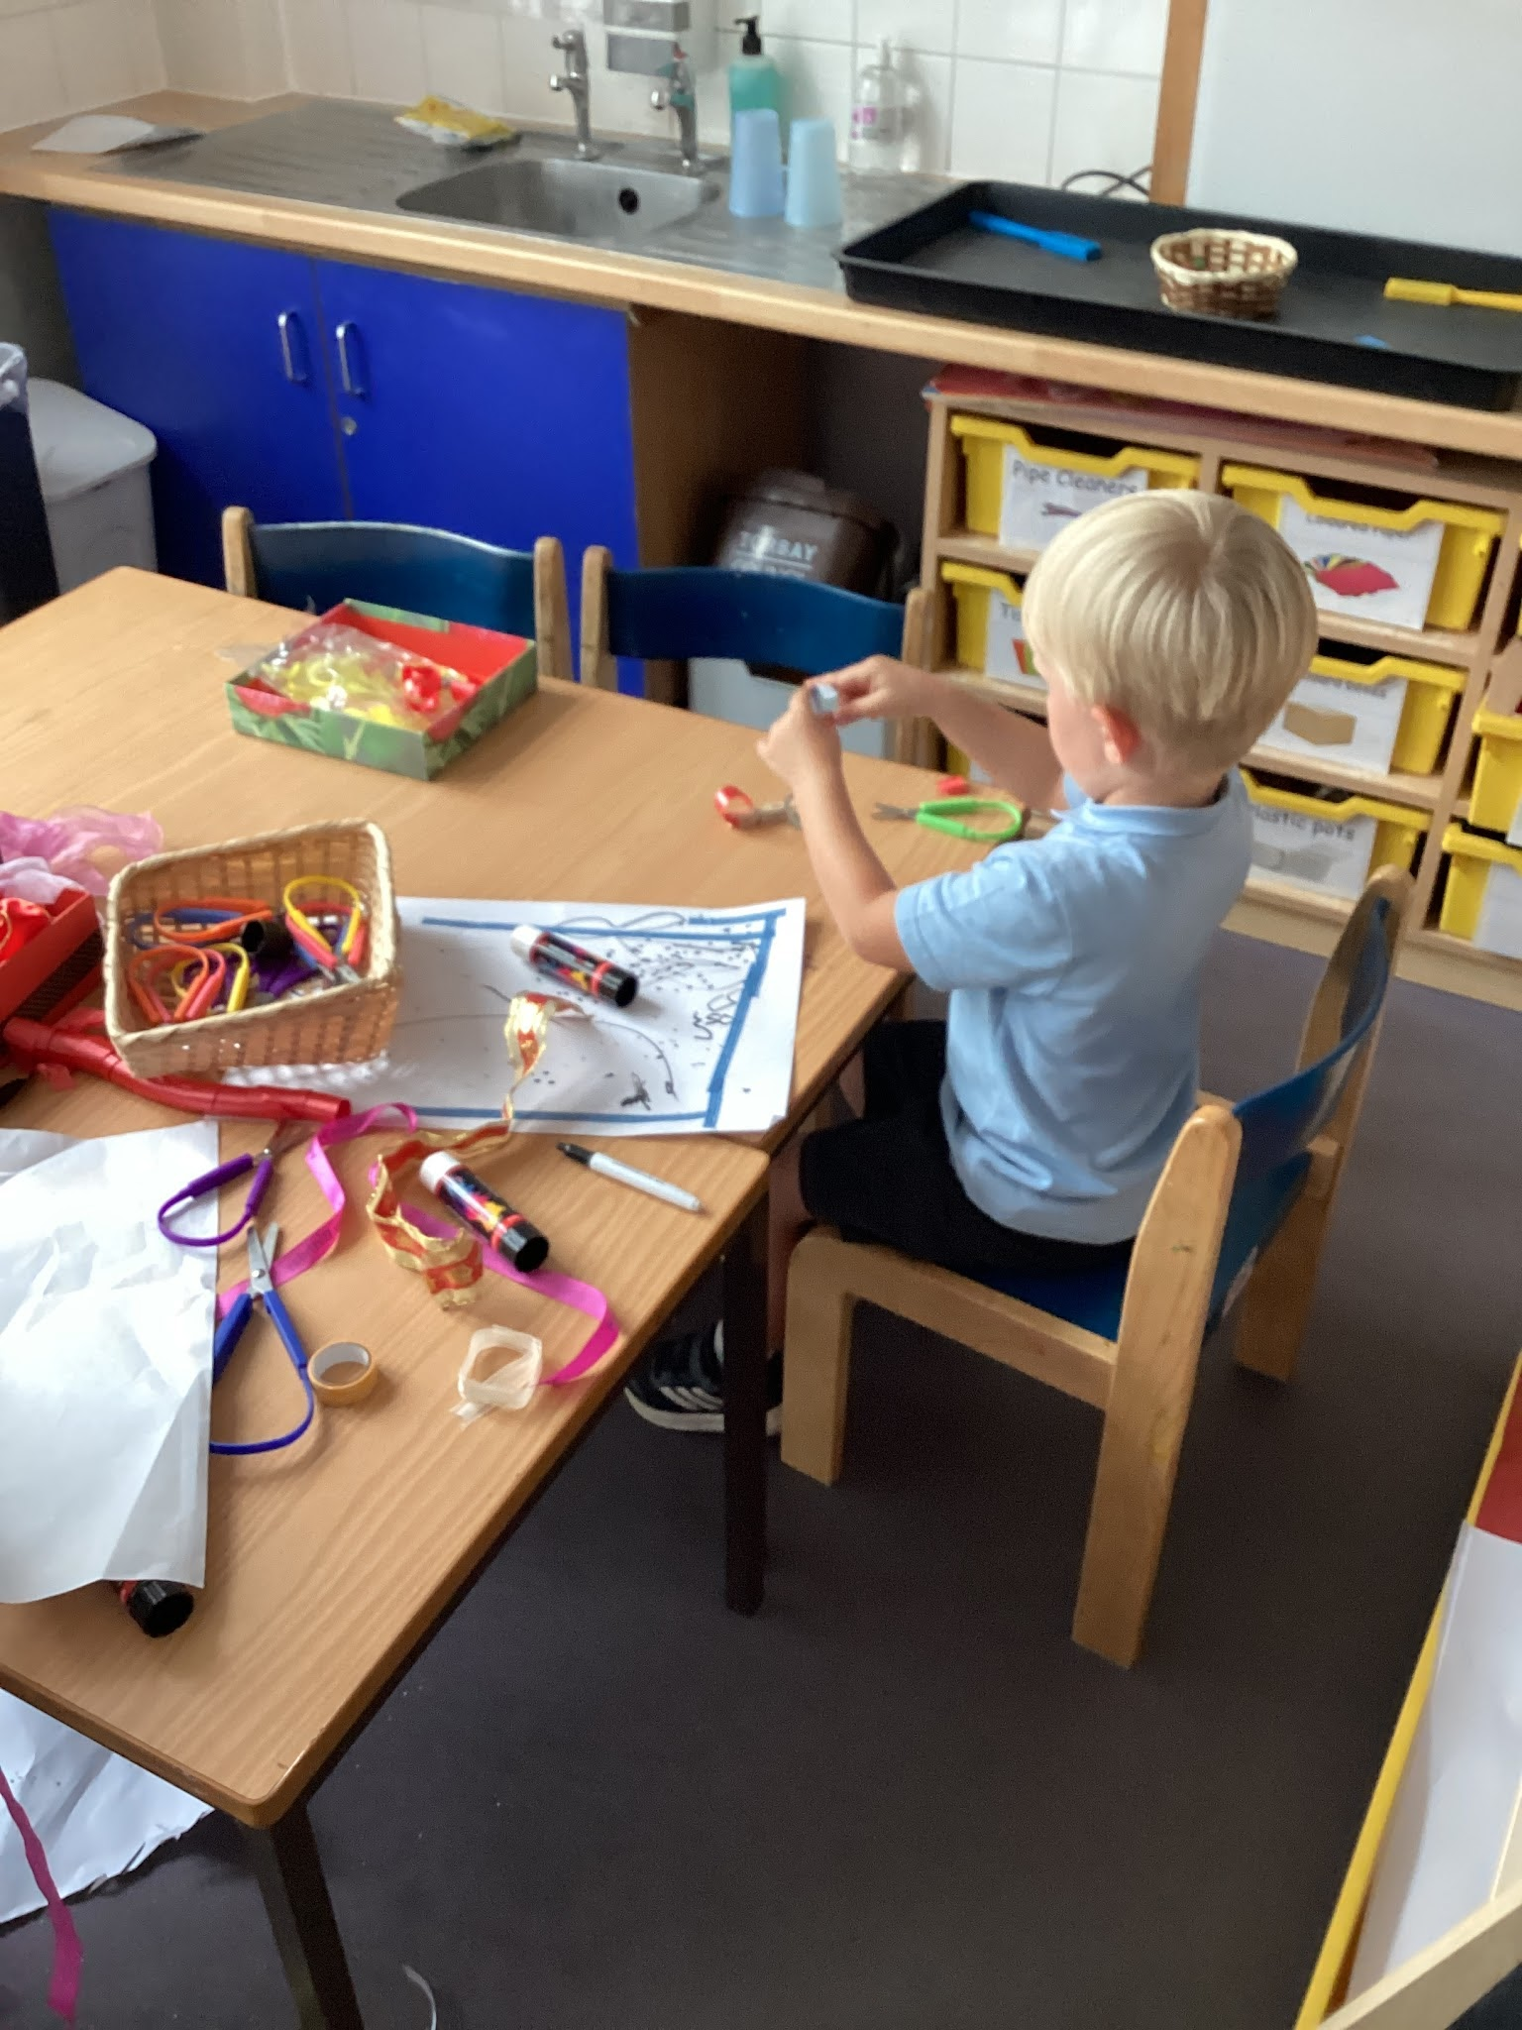
Nursery: Autumn 1 2026
Specific area: Expressive Arts and Design
Through this area of learning, the children will have opportunities to:
Begin to explore mixing colours
Mark make to explore faces
Join in with role play games
Follow their interests to make things
Join in with songs
Build models using construction equipment
Sing call and response songs
songs, so that children can echo phrases of songs you sing.

Slide 16
Nursery Staff
Year 5: Autumn 1
Reception Teachers
Mrs N El Haloul (Mrs El)
Cover teacher:
Mrs A Mason
Reception Teaching Assistants
Mrs J Eccles
Mrs B Wheatley
Mrs F Gibling (Monday-Thursday)
Mrs A Mason (Friday)
Mrs H Cranston (Monday- Wednesday)
Miss L Chalk (Thursday- Friday)

