Slide 1

Year 2 Curriculum Plan: Autumn 2026
The aim of Oldway Primary School is to provide opportunities for children to develop as independent, confident and successful learners, with high aspirations and the skills to make a positive contribution to their community.
We aim to provide a curriculum which is enriching and challenging, where children experience the opportunity to learn in a wide range of contexts with meaningful outcomes. The curriculum has been designed so that it:
supports pupils' personal development;
develops a love of learning;
prepares pupils for work and lifelong learning;
develops children as global citizens.

Slide 2

Year 2: Autumn 2026
Year 5: Autumn 1
READING through Read Write Inc.
Children have daily phonics lessons using Read, Write, Inc. programme which introduces new phonemes and consolidates prior learning in a systematic way so that children can apply these phonemes in their independent and guided reading and writing. Children are colour grouped according to ability. Some children will receive additional phonics support during the afternoons.
When children have finished the phonics programme, they move onto Read Write Inc. Comprehension. They read booklets and answer questions to develop their understanding of different texts.
Children then move into Whole Class Reading, where they will read and explore books from the year 2 recommended reads.
When in Comprehension & Whole Class Reading groups, children will bring home longer reading books.
WRITING using BookWrites
This half term, we are learning our grammar and writing skills through four books:
  Traction Man is here! By Mini Grey
  Don’t spill the milk by Stephen Davies
  How to hide a lion at school by Helen Stephens
  Snow in the garden by Shirley Hughes
We’ll be learning how to write different genres including stories, poetry, information texts and recounts of exciting experiences.
We will continue to focus on full stops and capital letters in longer pieces of writing, as well as other punctuation skills like commas in a list, apostrophes for possession and question marks.
We will also continue to apply our knowledge of word classes (nouns, adjectives, verbs and adverbs).

Slide 3




Reading Spine

Slide 4




BookWrites
You can help by: Listening to your child practise their Story & Speedy Green Words, reading with them daily and recording this in their reading record, allow time to practise spellings on Spelling Shed, reading aloud to them and visiting the local library.

Slide 5
Year 2: Autumn 2026
Year 5: Autumn 1
MATHS
Children have daily opportunities to develop mental strategies including recall of addition and subtraction facts for each number up to 10 then 20. Multiplication and division facts of the 2x, 10x and then 5x table are also introduced and extended depending on the child’s skill and understanding. The concept of more than/less than and the same as is practised for two-digit numbers up to 100. Counting forwards and backwards in a range of steps is also practised daily.
Number: This term, the children’s learning consolidates place value, understanding the value of each digit in a 2-digit number. Children will be introduced to specific strategies and are encouraged to make informal jottings to help them in their calculations, along with using maths apparatus. We also use word problems to ensure the children can apply their calculation skills in ‘real-life’.
Addition & Subtraction: Children will become more familiar adding and subtracting 1-digit and 2-digit numbers up to 100 this term. They will learn how to use practical equipment and then informal ‘jottings’ to support their thinking and begin to apply this when solving worded problems.
Shape: Towards the end of the autumn term, we will name and describe the properties of 2D and 3D shapes and sort shapes.
You can help by reinforcing number skills in everyday situations (e.g. asking questions like ‘How many more/less’ than?’ and ‘What’s the time?’), practising counting on and back in twos, threes, fives and tens. Numbots is an excellent resource for children to build their basic number knowledge and makes a huge difference to their confidence in maths. The children will have their log in details in their reading records.

Slide 6
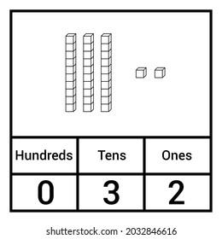
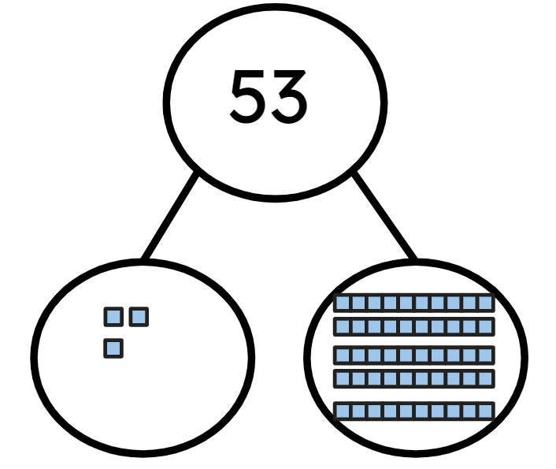
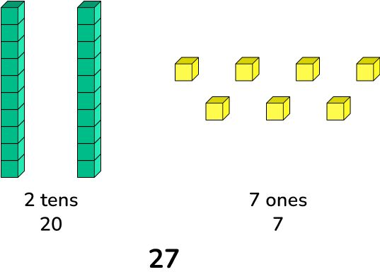
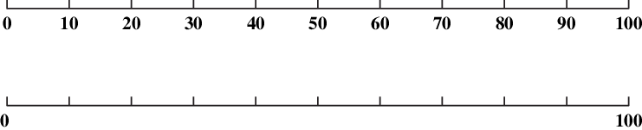
Maths - models and images
Place Value
Part-Whole Models
Place Value Chart and Place Value Counters
Base 10 Equipment/Dienes
Number Lines

Slide 7
Year 2: Autumn 2026
Year 5: Autumn 1
Science
In the topic ‘Plant Growth’, the children will be looking at a range of seeds and bulbs and learning the names of different parts of them. We will also learn about what seeds need to grow. After half term, we’ll be learning about the needs of animals including humans.
You can help by planting your own seeds at home.
Music
Music adds to the breadth of curriculum and experiences the children enjoy weekly.
This term, teaching concentrates on beat and rhythm, considering long and short sounds and the tempo of a variety of music.
We also have a weekly singing assembly where we develop our performance singing skills.
RE
The children will be exploring ‘Where is religion in our local community?’ They will look at a range of worldviews from different religions and learn the basic symbols and places of worship associated with the 5 main religions. After half term, our big question will be ‘What does it mean to be free?’ and we will look at how different religions approach this concept.
You can help by talking to your child about people having different beliefs.
PSHE
Pupils have regular PSHE sessions as well as assemblies each week. In the first half of the term, the children will discuss matters relevant to them, their behaviour and their relationships with others in school.
They will create class charter and select a School Council Rep and an Eco Warrior.

Slide 8
Year 2: Autumn 2026
Year 5: Autumn 1
PE
PE is timetabled weekly. This term the children will learn ball skills, fundamentals and they will swim weekly for the whole of the term.
Swimming for Saltern Cove will be on a Monday afternoon, and Oyster Cove will swim on a Friday afternoon.
PE kit is essential on: Tuesdays for both classes. Children can come into school on PE days wearing their PE kit.
You can help by: making sure your child has named kit with the correct items.
Computing
The children start by learning about the importance of staying safe online.
They will set their own passwords and then log in and off of the Chromebooks.
They will be using Chromebooks to create Google slides.
The children will also be using a range of new technologies including iPads and other tablets.
Geography
In Geography children will learn all about maps. We will learn about the 4 main compass points and will explore different symbols that can be used on maps. We will have a go at drawing maps to scale.
Art
The children will develop their understanding of pattern and texture through photography and printmaking. We will be focusing on the artist Zaha Hadid and The Boyle Family.

Slide 9
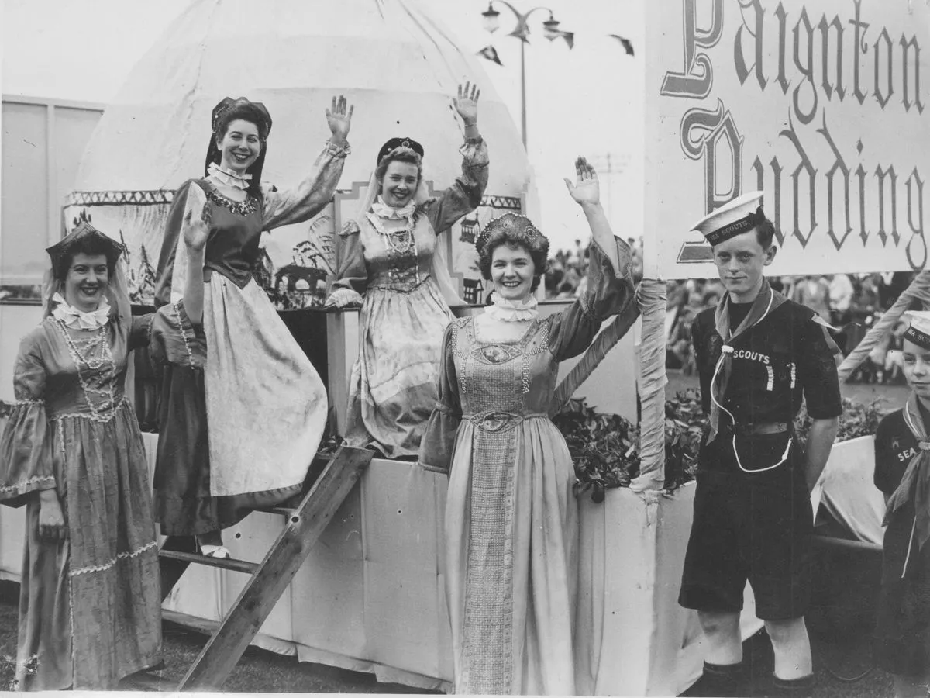
Year 2: Autumn 2026
Year 5: Autumn 1
Design and technology
The children will make a smoothie in food technology.
We will learn about different fruits and vegetables and how to combine them to make a delicious drink.
History
Year 2 will be learning about a significant event in our local history… the Paignton Pudding Riot!
French
Year 2 classes have regular French lessons. This term, using Language Angels programme, our focus is on vocabulary and phrases associated with numbers and colours.

Slide 10
Home Learning
Year 5: Autumn 1
Reading
In Year 2, children should be reading every night and should read both phonics books multiple times before they are changed (every 3 or 5 days).When on Comprehension or Whole Class Reading, children will bring home longer chapter books that should take longer to read. Please encourage your child to read as frequently as possible at home; this can have a huge impact on their learning.
Spellings
Children are set new spellings every Wednesday and will be tested the following Wednesday. We practice spellings in class every day but children have access to Spelling Shed to practise at home with fun games. Children in RWI phonics groups will also have spellings they have been learning in their story books that week.
Maths
Children can use Numbots to practise their basic number facts and understanding. Once they have completed multiplication & division in maths in class, they will be shown how to use TTRS

Slide 11
Behaviour
Year 5: Autumn 1
We continue to work across the curriculum to develop co-operative learning and social skills. Pupils are encouraged to discuss matters relevant to them, their behaviour and their relationships with others. The School takes a trauma-informed approach to managing behaviour.
The school operates a Positive Behaviour Policy. Rewards take the form of verbal praise, House points, certificates and ‘marbles-in-the-jar’ for effort and attainment across the whole range of school activity, linked to Oldway’s values. Certificates are presented to the children in Celebration Assembly on Friday mornings and each half term, when the marble jar has been filled and the marbles counted, the class is entitled to a class treat - enjoyed by all. Additional certificates are awarded for good behaviour and cooperative play at lunch times. Children who continuously make good choices will be nominated for an ‘Ice Lolly with the Head’ and others may receive a ‘Golden Phone Call.’
Consequences vary according to the seriousness of the incident and/or behaviour. On occasion, children are required to finish class activities at playtime or at home if lesson time has been missed by poor behaviour in class. Missed break time or lunchtime operates as a sanction when things go ‘more wrong’. During this time, children will be able to reflect on how to improve their behaviour and decide ‘how to make things right’. When poor or inappropriate behaviour is persistent, parents are contacted and are asked to discuss concerns with either Mrs Milligan (Assistant Head), Miss Eva Rowe/ Mrs L Chalk (Family Support Workers), Mrs Laura Bateman (SENCO), Mr Chris Hallett (Deputy Headteacher) or Mrs Emma Bamber (Headteacher).
When there are questions or concerns, your first point of contact should be the class teacher, who knows your child best. In addition, Miss Worthington (Year Leader) is also available to give assistance.

Slide 12
Year 2 Staff
Year 5: Autumn 1
Y2 Teachers
Miss K Squirrell (Oyster Cove)
Miss R Caulfield (Saltern Cove)
Y2 Support Staff
Mrs C Powell
Mrs L Marsden
Mrs D Churchward
Y2 Mealtime assistants
Mrs Z Haycock
Mrs L Marsden

