Slide 1

Year 3 Curriculum Plan: Autumn 2026
The aim of Oldway Primary School is to provide opportunities for children to develop as independent, confident and successful learners, with high aspirations and the skills to make a positive contribution to their community.
We aim to provide a curriculum which is enriching and challenging, where children experience the opportunity to learn in a wide range of contexts with meaningful outcomes. The curriculum has been designed so that it:
supports pupils' personal development;
develops a love of learning;
prepares pupils for work and lifelong learning;
develops children as global citizens.

Slide 2

Year 3: Autumn 2025
Year 5: Autumn 1
READING from the Reading Spine
Our core book at the start of this term is Oliver and the Seawigs. We will be reading this book daily as part of our Read at 3 and most children will be analysing key chapters within our daily reading lessons.
To link to our science and history topics, we will also be reading the following texts during our daily reading lessons:
Stone Age and The Street Beneath My Feet
Each term, we also read and perform a selection of poems.
In addition to this, the children have the opportunity to read for pleasure regularly. Our Bookopoly challenge is used to encourage the children to read a breadth of books at an appropriate level.
WRITING using BookWrites
To begin the term, we will be teaching writing using The Disgusting Sandwich by Gareth Edwards and Hannah Shaw (fiction) then Rocks (Science in a Flash) by Georgia Amson-Bradshaw (non-fiction). The children will write stories set in a similar setting with a similar plot.
Following this, the children will write a further non-fiction text based on Dare to Care: Pet Dragon. Finally, they will watch a Christmas advert called Mog’s Christmas Calamity and write a story to go alongside the video.
Weekly spellings are taught in discrete lessons. We will set a weekly spelling assignment on Spelling Shed and children should practise their spellings, using Spelling Shed, at least three times each week.
Handwriting is taught using the Nelson scheme.

Slide 3

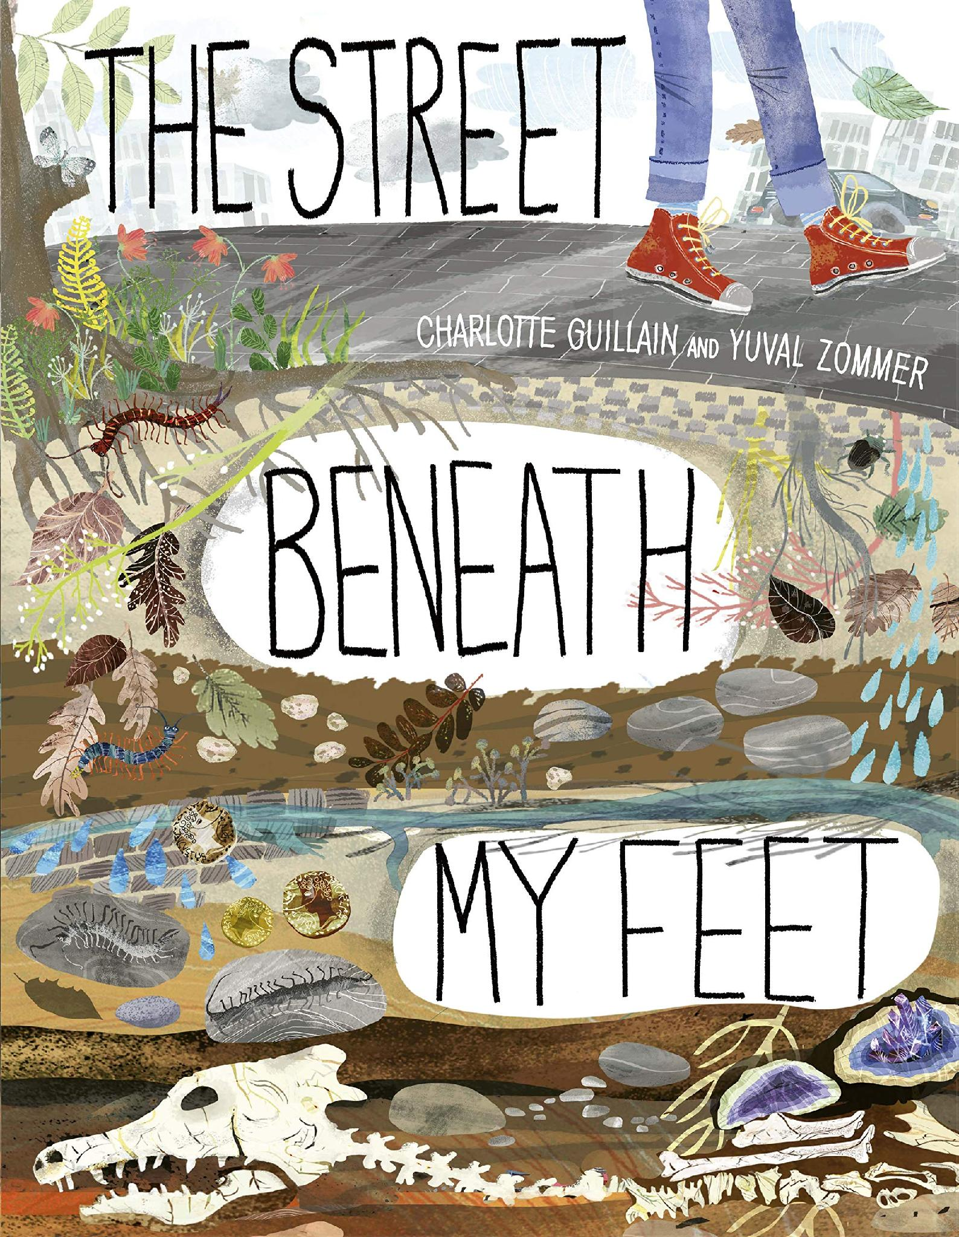


Reading Spine

Slide 4
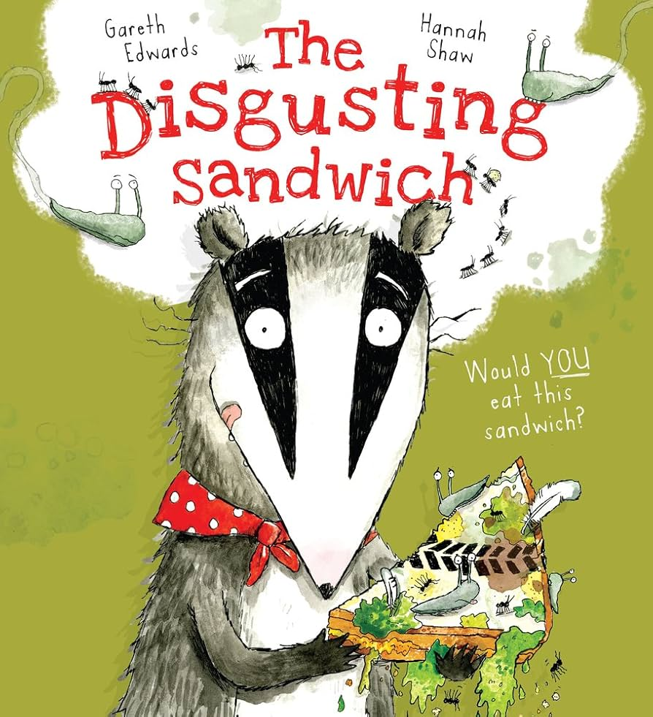
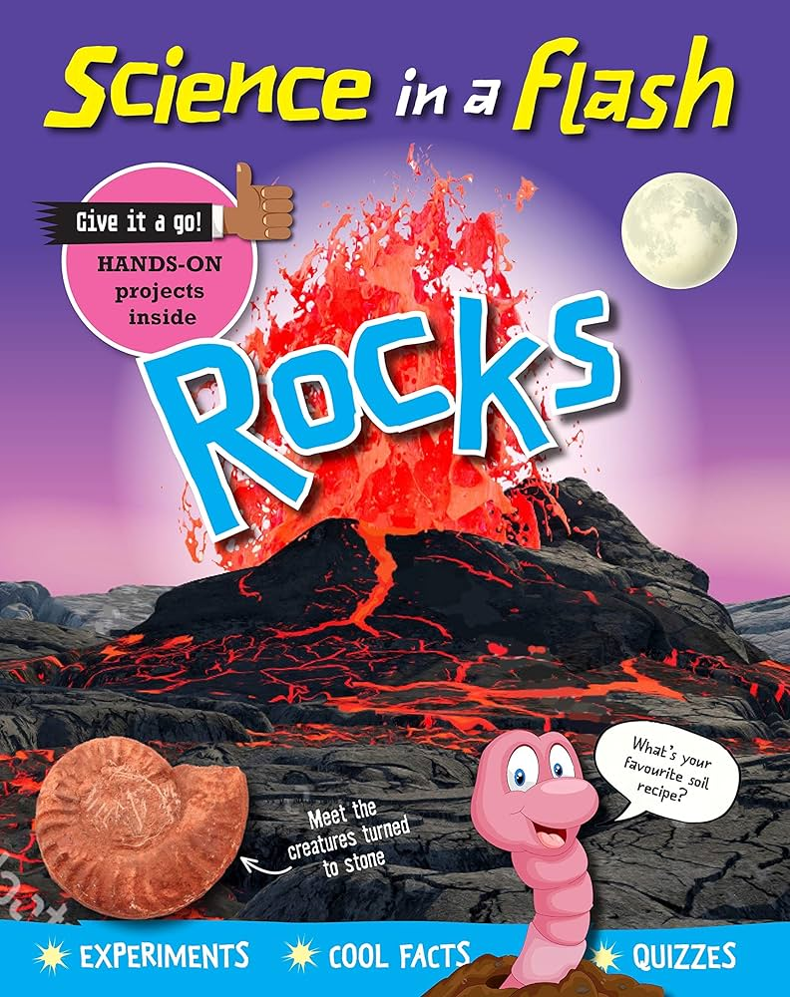
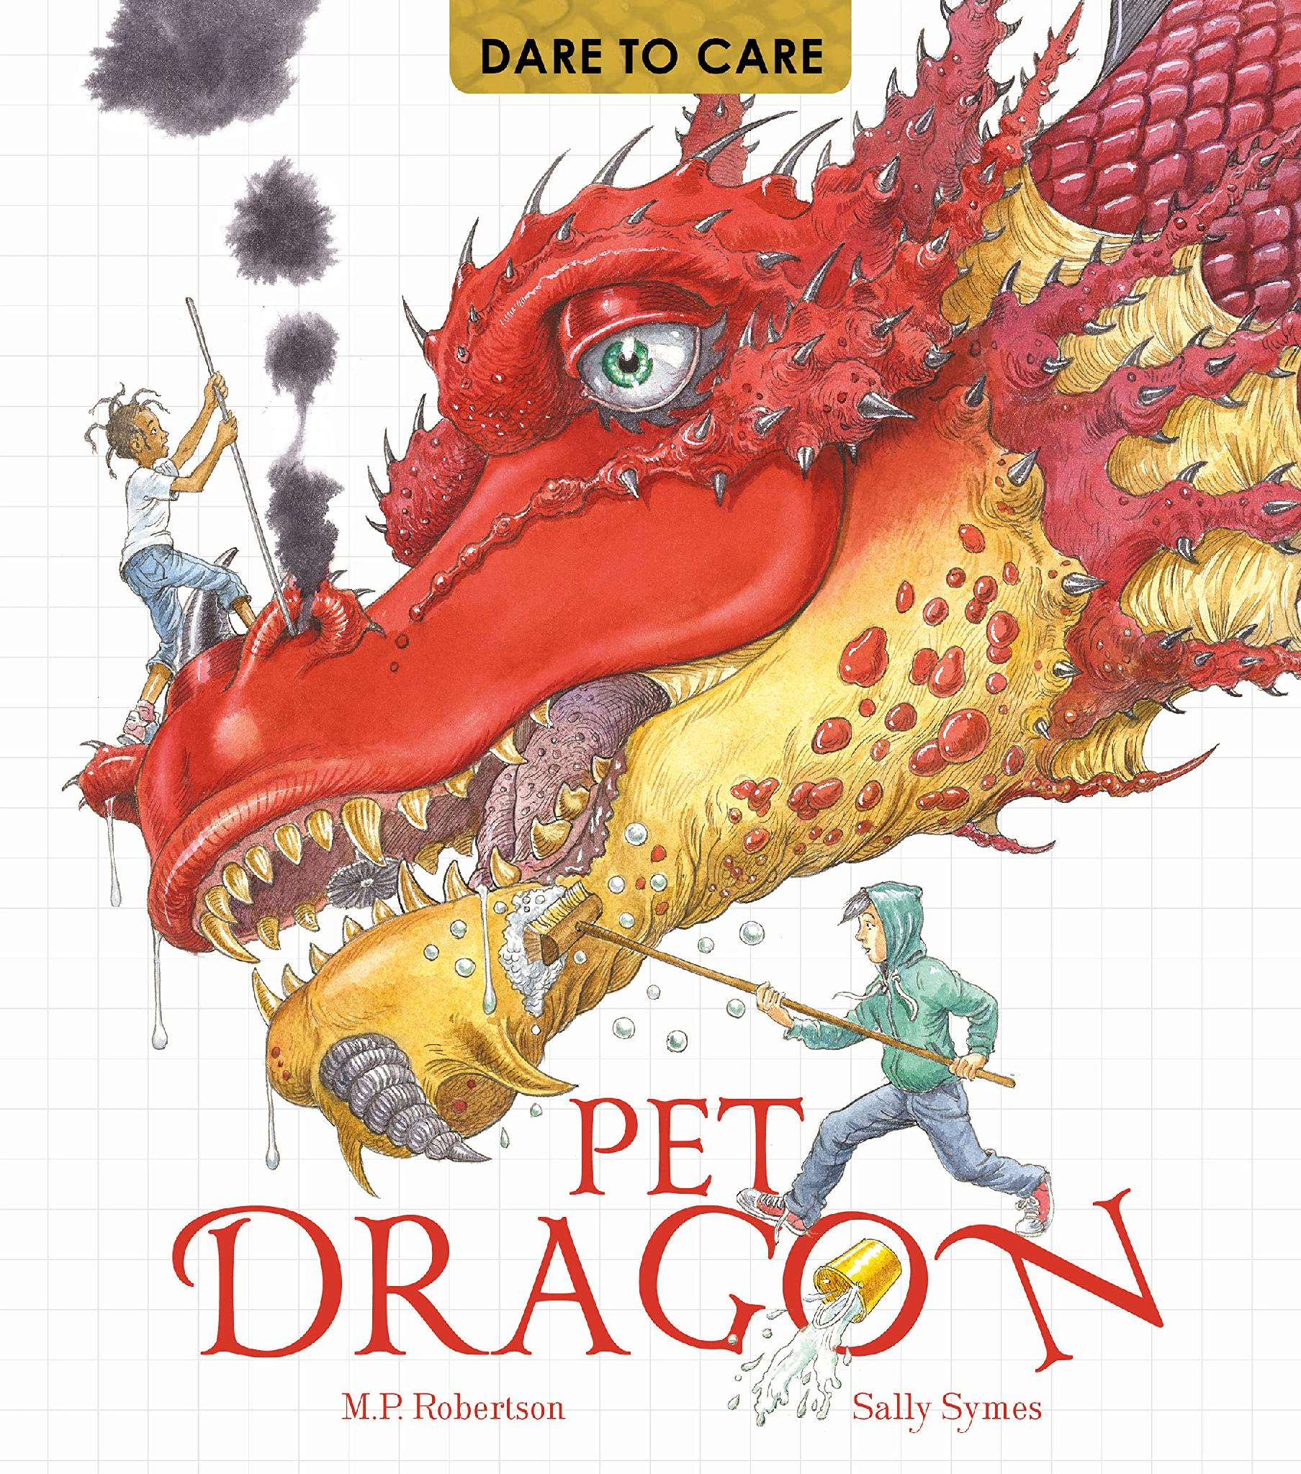
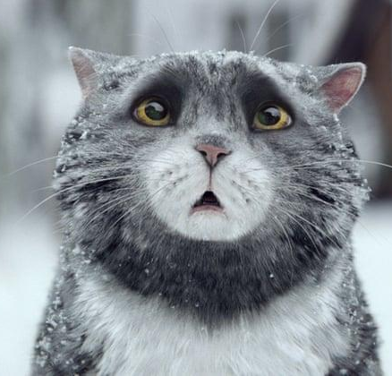
BookWrites
You can help by: Encouraging your child to practise spellings; by listening to and encouraging your child to read regularly; reminding them to change their reading book in the mornings; by discussing books read, checking in on their Bookopoly challenge and by visiting the library.

Slide 5
Year 3: Autumn 2026
Year 5: Autumn 1
MATHS
The children are taught maths daily, always in the morning. In each lesson, children practise and develop oral and mental skills (counting, mental strategies, rapid recall of addition, subtraction, multiplication and division facts). They will also develop calculation skills by increasing fluency in all operations as well as developing their problem solving and reasoning strategies and skills.
This term we are focusing on place value for 3-digit numbers (hundreds, tens and ones), addition, subtraction, multiplication and division. This will give the children a solid foundation for the rest of the year. Once secure in place value and their prior learning, children will be developing their understanding of formal written methods (column method for addition and subtraction, short multiplication). As we complete maths topics, we will be putting videos on SeeSaw to show children and parents the different methods we have learned. These videos will help you to understand the methods we’re expecting your child to use, as it may be slightly different from how you were taught.
You can help by: Revisiting times tables with your child daily, ensuring that they have instant recall of the following times table facts and know all their corresponding division facts: 2, 5, 10, 3, 4 and 8.

Slide 6
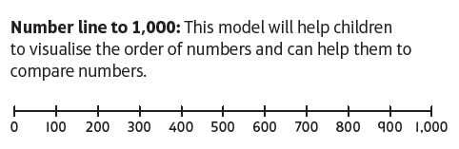
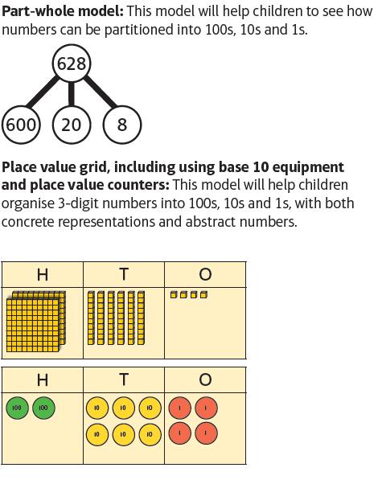
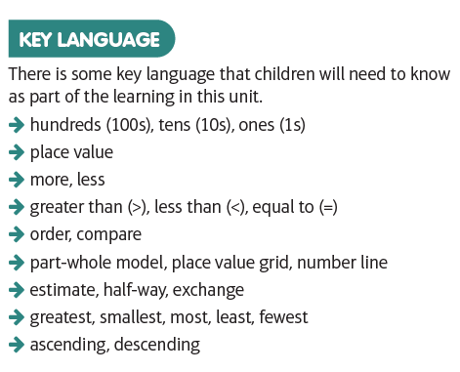
Models, images and language
Maths - Place Value

Slide 7
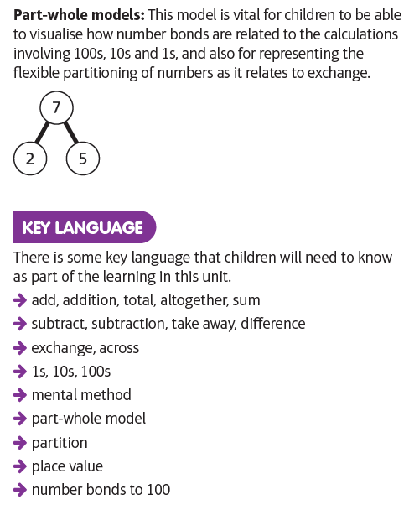
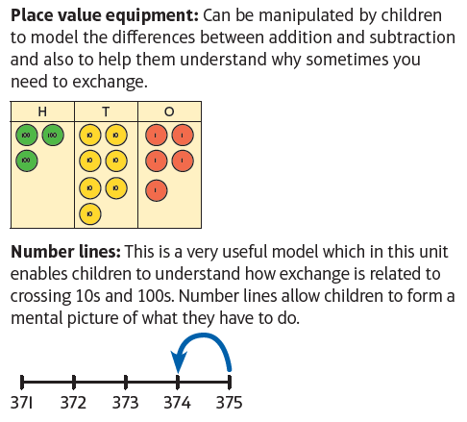
Models, images and language
Maths – Addition and Subtraction

Slide 8
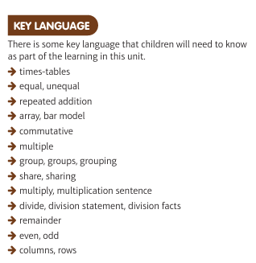
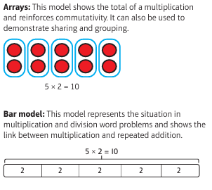
Models, images and language
Maths – Multiplication and Division

Slide 9
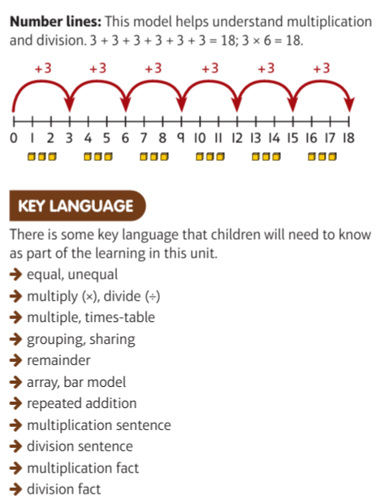
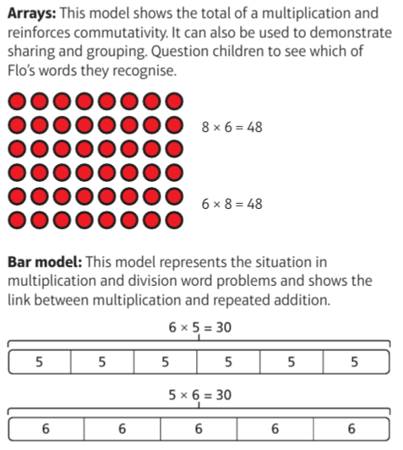
Models, images and language
Maths – Multiplication and Division 2

Slide 10
Year 3: Autumn 2026
Year 5: Autumn 1
Geography
In Geography, our autumn topic is the United Kingdom. The children will locating the UK, Great Britain and the British Isles, and regions and counties; identifying physical features and regeneration of one region.
You can help by:
Looking at maps, talking about our region and regions you may have visited.
Science: Rocks and Fossils
This term we will be learning about rocks and fossils. We will compare and group together different kinds of rocks, describe in simple terms how fossils are formed when things that have lived are trapped within rock and recognise that soils are made from rocks and organic matter.
You can help by:
Looking at different rocks in your area and maybe even fossils.
DT: Engineering - Moving Parts
In DT we will be researching, designing, making and evaluating a moving Christmas Card. We will look at moving parts and levers and how they work. The children will then design and create a moving part to fit within a Christmas Card.
RE: (1) How do people think about the Bible? (2) What is the Trinity?
In these units, the children will be exploring Christianity. We will look at its origins, content and significance. We will then look at the Holy Trinity.

Slide 11
Year 3: Autumn 2025
Year 5: Autumn 1
PE
Outdoor: Ball skills
Indoor: Gymnastics
PE takes place twice a week. In our indoor sessions, we will be looking at coordination and static balance. For outdoor PE, the children will be looking at a variety of different sports and skills.
PSHE: Social and Health Education
Children will learn about Oldway’s school values during assemblies each week, and how these apply to everyday life for them. Our PSHE curriculum will initially focus on class rules and & behaviours. We will then be thinking about ourselves, what makes us special and feel happy.
Computing: Slides
This term the children will be introduced to Google Slides and create their very own slide show about the Stone Age.
French: Animals
For language the children will be learning some basic French phrases including numbers, colours and some greetings.
Music – Ukulele
We will be developing our ukulele technique from Year 2 by learning to play new chords. We will play as an ensemble and increase our confidence to play in smaller groups.

Slide 12
Year 3: Autumn 2025
Year 5: Autumn 1
History – Stone Age
We will be learning how settlements, food, communities and beliefs changed across the Palaeolithic, Mesolithic, Neolithic, Bronze Age and Iron Age.
We will also be taking a trip to Kent’s Cavern on either the 12th or 13th of November.
Art – Why we make art?
In Art, the children will be exploring the purpose of art through the study of cave paintings from Lascaux. Using continuous line and considering the use of perspective.
Some arts we will be looking at are:
Satoshi Kitamura
Pablo Picasso

Slide 13
Home Learning
Year 5: Autumn 1
Reading
In Year 3, children should be reading everyday and to an adult at home at least four times per week for at least 15 minutes. Children should record their reading, daily, in their reading record. Please encourage your child to read as frequently as possible at home; this can have a huge impact on all areas of their learning.
Spellings
A spelling assignment will be set each Friday and weekly spellings will be tested the following Friday. Children should practise their spellings using Spelling Shed. Children should play at least three games on Spelling Shed per week.
Maths
Children should use Times Tables Rock Stars to ensure that they have a rapid recall of all multiplication and division facts up to the 8 times table. We recommend that children practise at home at least three times a week for 15-20 mins.

Slide 14
Behaviour
Year 5: Autumn 1
We continue to work across the curriculum to develop co-operative learning and social skills. Pupils are encouraged to discuss matters relevant to them, their behaviour and their relationships with others. The School takes a trauma-informed approach to managing behaviour.
The school operates a Positive Behaviour Policy. Rewards take the form of verbal praise, House points, certificates and ‘marbles-in-the-jar’ for effort and attainment across the whole range of school activity, linked to Oldway’s values. Certificates are presented to the children in Celebration Assembly on Friday mornings and each half term, when the marble jar has been filled and the marbles counted, the class is entitled to a class treat - enjoyed by all. Additional certificates are awarded for good behaviour and cooperative play at lunch times. Children who continuously make good choices will be nominated for a ‘Hot Chocolate with the Head’ and others may receive a ‘Golden Phone Call.’
Consequences vary according to the seriousness of the incident and/or behaviour. On occasion, children are required to finish class activities at playtime or at home if lesson time has been missed by poor behaviour in class. Missed break time or lunchtime operates as a sanction when things go ‘more wrong’. During this time, children will be able to reflect on how to improve their behaviour and decide ‘how to make things right’. When poor or inappropriate behaviour is persistent, parents are contacted and are asked to discuss concerns with either Mrs Milligan (Assistant Head), Miss Eva Rowe/ Mrs L Chalk (Family Support Workers), Mrs Laura Bateman/ Lynn Oliver (SENCOs), Mr Chris Hallett (Deputy Headteacher) or Mrs Emma Bamber (Headteacher).
When there are questions or concerns, your first point of contact should be the class teacher, who knows your child best. In addition, Mrs Milligan (Assistant Head) is also available to give assistance.

Slide 15
Year 3 Staff
Year 5: Autumn 1
Y3 Teachers
Miss Worthington/Mrs Rendell (Friday) Babbacombe Beach
Mr Turner Oddicombe Beach
Mrs Claridge (Mon – Wed) and Mrs Wingrove (Thurs – Fri) Meadfoot Beach
Y3 Teaching Assistants
Miss Roberts (HLTA)
Mrs Moylan-Jones
Mrs Court

