Slide 1

Year 4 Curriculum Plan: Autumn 2026
The aim of Oldway Primary School is to provide opportunities for children to develop as independent, confident and successful learners, with high aspirations and the skills to make a positive contribution to their community.
We aim to provide a curriculum which is enriching and challenging, where children experience the opportunity to learn in a wide range of contexts with meaningful outcomes. The curriculum has been designed so that it:
supports pupils' personal development;
develops a love of learning;
prepares pupils for work and lifelong learning;
develops children as global citizens.

Slide 2

Year 4: Autumn 2026
Year 5: Autumn 1
READING from the Reading Spine
Our core book at the start of this term is The Miraculous Journey of Edward Tulane by Kate DiCamillo. We will be reading this book daily as part of our Read at 3 and will also be analysing key chapters within our daily reading lessons.
To link to our history topic, we will also be reading the following texts during our daily reading lessons:
Uncover |History – The Maya by Claire Hibbert
DK Findout! Maya, Incas and Aztecs
Each term, we also read and perform a selection of poems.
In addition to this, the children have the opportunity to read for pleasure regularly. Our Bookopoly challenge is used to encourage the children to read a breadth of books at an appropriate level.
WRITING using BookWrites
In the first half term, we will be teaching narrative writing using Gregory Cool by Carline Binch and non-fiction writing using An Anthology of Intriguing Animals by Ben Hoare. The children will write stories based on the theme and structure of Gregory Cool and will research and write an information page about an animal of their choice.
Following this, the children will write, and perform, poems based on their reading of Poetry Pie by Roger McGough and will write their own story chapter for the book The Snowman by Michael Morpurg.
Weekly spellings are taught in discrete lessons. We will set a weekly spelling assignment on Spelling Shed each Friday and children should practise their spellings, using Spelling Shed, at least three times each week.
Handwriting is taught using the Nelson scheme.

Slide 3

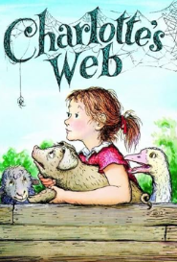
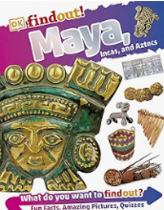

Reading Spine

Slide 4




BookWrites
You can help by: Encouraging your child to practise spellings; by listening to and encouraging your child to read regularly; reminding them to change their reading book in the mornings; by discussing books read, checking in on their Bookopoly challenge and by visiting the library.

Slide 5
Year 4: Autumn 2026
Year 5: Autumn 1
MATHS
In maths, we will begin the term with two units which extend our learning about place value, from Year 3. The children will learn to represent and partition 4-digit numbers into 1000s, 100s, 10s and 1s, and in more flexible ways. They will find 1,10,100 or 1000 more/ less than any given number. They will also explore number lines to 10,000, comparing and ordering numbers and rounding to the nearest 1000, 100 or 10.
Moving forward, the children will build on their learning about addition, subtraction, multiplication and division. They will learn to add and subtract 4-digit numbers, including where the calculation requires more than one exchange. The children will also develop efficient mental calculation methods and will solve multi-step problems.
In our measure block, the children will explore area. They will learn to measure area using squares and will learn to
compare areas.
The children will spend the rest of this term reviewing and learning table facts, which are essential for efficient, fluent
maths work in almost all areas.
You can help by: Revisiting times tables with your child daily, ensuring that they have instant recall up to 12 x 12 and know all their corresponding division facts.

Slide 6
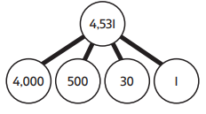



Maths - models and images
Place Value
Part-Whole Models
Base 10 Equipment
Place Value Chart and Place Value Counters
Number Lines

Slide 7
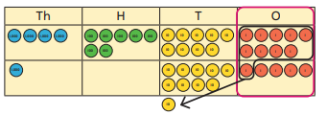


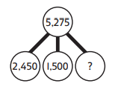

Maths - models and images
Addition and Subtraction
Multiplication and Division
Place Value Chart
Number Lines
Arrays
Part-Whole Models
Bar Models

Slide 8
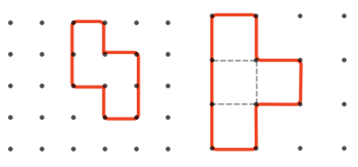
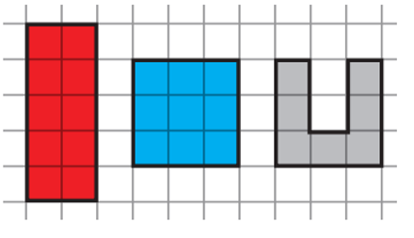
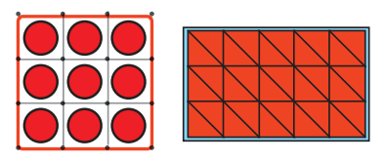
Maths - models and images
Measure - Area
Squared Paper and Squared Dotted Paper Overlaid with 2D Shapes or Counters

Slide 9
Year 4: Autumn 2026
Year 5: Autumn 1
History: Ancient Maya
In the second half term, we will look at when the ancient Maya civilisation existed. We will look at how the Maya organised and ruled their cities.
You can help by:
Visiting the local library to read about the ancient Maya; asking your child to share their developing knowledge with you.
Science: (1) Classification (2) Food and Digestion
During the first half term, we will be studying organisms (living things) with a particular focus on classification. We will look at vertebrates and invertebrates and different types of skeletons.
In the second half term, we will study food and digestion. We will learn about the parts of the digestive system, different types of teeth and about ecosystems and food chains.
DT: Engineering: Structures
In DT, in the second half term, we will be using computer-aided design to create festive gift boxes.
You can help by:
Exploring box nets by unfolding box packaging at home and discussing the construction.
RE: Our focus this term is What do we mean by truth? We will explore how we use evidence and reasoning to make decisions and the difference between empirical and theoretical evidence.
We will be introduced to the famous philosopher, Plato.
You can help by:
Talking to your child about the
difference between fact and opinion and discussing
different perspectives and worldviews.

Slide 10
Year 4: Autumn 2026
Year 5: Autumn 1
PE
PE takes place twice a week. Indoor PE is on Wednesdays. In the first half term, we will be focusing on yoga. Mindful Movement means thinking carefully about how our body moves and feels. We use poses, movement and breathing to develop our physical and mental wellbeing. During the second half term, we will be focusing on gymnastics.
Outdoor games will take place on a Monday. In games, this term, we will be focusing on invasion games with tag rugby in the first half term and netball in second half term.
PSHE: (1) Families, Friendship and Relationships (2) Changes, Transitions and Maintaining Positivity
During the first unit, we will develop an understanding of what is required in order to manage our feelings and emotions; how to resolve conflicts and stay safe; and how stereotypes come about. In the second half term, the children will learn about factors affecting physical and mental health.
After half term, we will also be completing our statutory Relationships, Sex and Health education and more information will follow.
Computing: Google Docs
During our word processing lessons, the children will be taught changing case, aligning text, using bullets and numbering, adding text boxes and using keyboard shortcuts. They will also be taught how to format an image.
You can help by:
Encouraging the use of Google Docs at home.
French: (1) Greetings (2) Fruits
French lessons/ practice will take place weekly for each class in the year group. Children will be introduced to new vocabulary through games and songs so that children can name objects, follow instructions and talk about themselves.
You can help by:
Asking your child to share their new words and phrases with you.

Slide 11
Year 4: Autumn 2026
Year 5: Autumn 1
Geography: Brazil
We will study Brazil in the first half term. Children will learn about the equator and hemispheres and the countries which make up South America. We will focus on Brazil, as the largest country in South America, and explore some of its features.
You can help by:
Exploring atlases and maps with your child, both in books and online, and using books/the internet to research facts about Brazil.
Art: Patterns and Pumpkins
During the first half term, we will be studying the work of contemporary artist, Yayoi Kusama. We will sculpt from clay, and decorate, ceramic pumpkins in the style of her work
You can help by:
Looking at Yayoi Kusama’s ceramic work online.
Music: Glockenspiels – Treble Clef Staff
The children will explore Japanese music and the pentatonic scale. They will perform the piece ‘Sakura’ on glockenspiels.
You can help by:
Listening to performances and helping pupils to discriminate between the different instruments.

Slide 12
Home Learning
Year 5: Autumn 1
Reading
In Year 4, children should be reading at least four times per week for at least 15 minutes (ideally, daily). Children should record their reading, daily, in their reading record. Please encourage your child to read as frequently as possible at home; this can have a huge impact on all areas of their learning.
Spellings
A spelling assignment will be set each Friday and weekly spellings will be tested the following Friday. Children should practise their spellings using Spelling Shed. Children should play at least three games on Spelling Shed per week.
Maths
Children should use Times Tables Rock Stars to ensure that they have a rapid recall of all multiplication and division facts up to 12 x 12. We recommend that children practise at home at least four times a week for 15-20 mins.

Slide 13
Behaviour
Year 5: Autumn 1
We continue to work across the curriculum to develop co-operative learning and social skills. Pupils are encouraged to discuss matters relevant to them, their behaviour and their relationships with others. The School takes a trauma-informed approach to managing behaviour.
The school operates a Positive Behaviour Policy. Rewards take the form of verbal praise, House points, certificates and ‘marbles-in-the-jar’ for effort and attainment across the whole range of school activity, linked to Oldway’s values. Certificates are presented to the children in Celebration Assembly on Friday mornings and each half term, when the marble jar has been filled and the marbles counted, the class is entitled to a class treat - enjoyed by all. Additional certificates are awarded for good behaviour and cooperative play at lunch times. Children who continuously make good choices will be nominated for an ‘Ice Lolly with the Head’ and others may receive a ‘Golden Phone Call.’
Consequences vary according to the seriousness of the incident and/or behaviour. On occasion, children are required to finish class activities at playtime or at home if lesson time has been missed by poor behaviour in class. Missed break time or lunchtime operates as a sanction when things go ‘more wrong’. During this time, children will be able to reflect on how to improve their behaviour and decide ‘how to make things right’. When poor or inappropriate behaviour is persistent, parents are contacted and are asked to discuss concerns with either Mrs Milligan (Assistant Head), Miss Eva Rowe/ Mrs L Chalk (Family Support Workers), Mrs Laura Bateman (SENDCO), Mr Chris Hallett (Deputy Headteacher) or Mrs Emma Bamber (Headteacher).
When there are questions or concerns, your first point of contact should be the class teacher, who knows your child best. In addition, Mrs Milligan (Assistant Head) is also available to give assistance.

Slide 14
Year 4 Staff
Year 5: Autumn 1
Y4 Teachers
Mrs Z Milligan – Assistant Headteacher (Anstey’s Cove)
Miss Lucy Roach (Beacon Cove)
Mrs H Christopher (Hope Cove)
Y4 Teaching Assistants
Mrs K Layland (HTLA)
Mrs K Harris
Mrs D Court (Year 3 and 4 support)

