Slide 1

Year 6 Curriculum Plan: Autumn 2026
The aim of Oldway Primary School is to provide opportunities for children to develop as independent, confident and successful learners, with high aspirations and the skills to make a positive contribution to their community.
We aim to provide a curriculum which is enriching and challenging, where children experience the opportunity to learn in a wide range of contexts with meaningful outcomes. The curriculum has been designed so that it:
supports pupils' personal development;
develops a love of learning;
prepares pupils for work and lifelong learning;
develops children as global citizens.

Slide 2

Year 6: Autumn 2026
Year 5: Autumn 1
READING from the Reading Spine
Our core book this term is Malamander by Thomas Taylor. We will be reading this book daily for our Read at 3.
In Autumn 1, to link to our history topic (Ancient Rome), we will also be reading the following texts as part of our daily reading lesson:
-Ancient Rome- Aquila
-Delta and the Lost City by Anna Fargher
-Pompeii- Aquila
In Autumn 2, to link to our geography topic (Environment) and our writing (Twisted Fairytales), we will be reading the following texts as part of our daily reading lesson:
-The Lost Happy Endings by Carol Ann Duffy
-The True Story of the Three Little Pigs by Jon Scieszka
-Natural Wonders of the World By Molly Oldfield

Slide 3

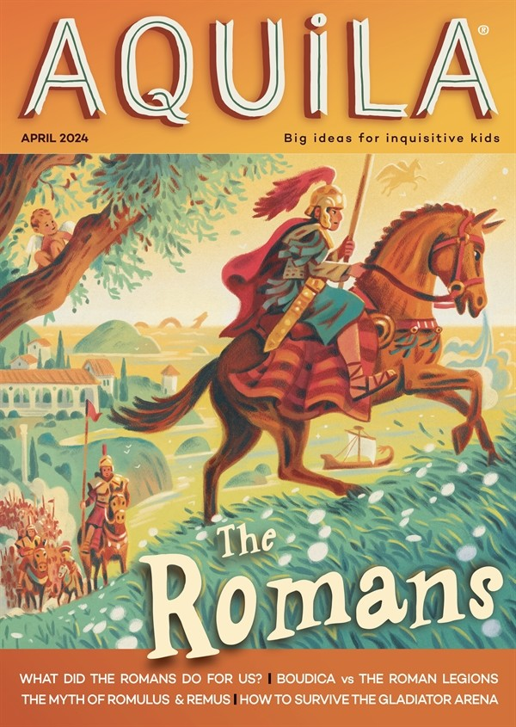
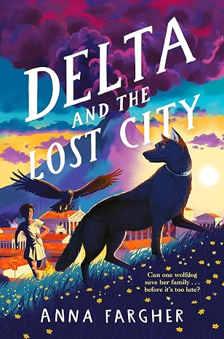
Reading Spine- Autumn 1
You can help by: Encouraging your child to practise spellings, by listening to and encouraging your child to read regularly, reminding them to change their reading book in the mornings, by discussing books read and by visiting the library.

Slide 4
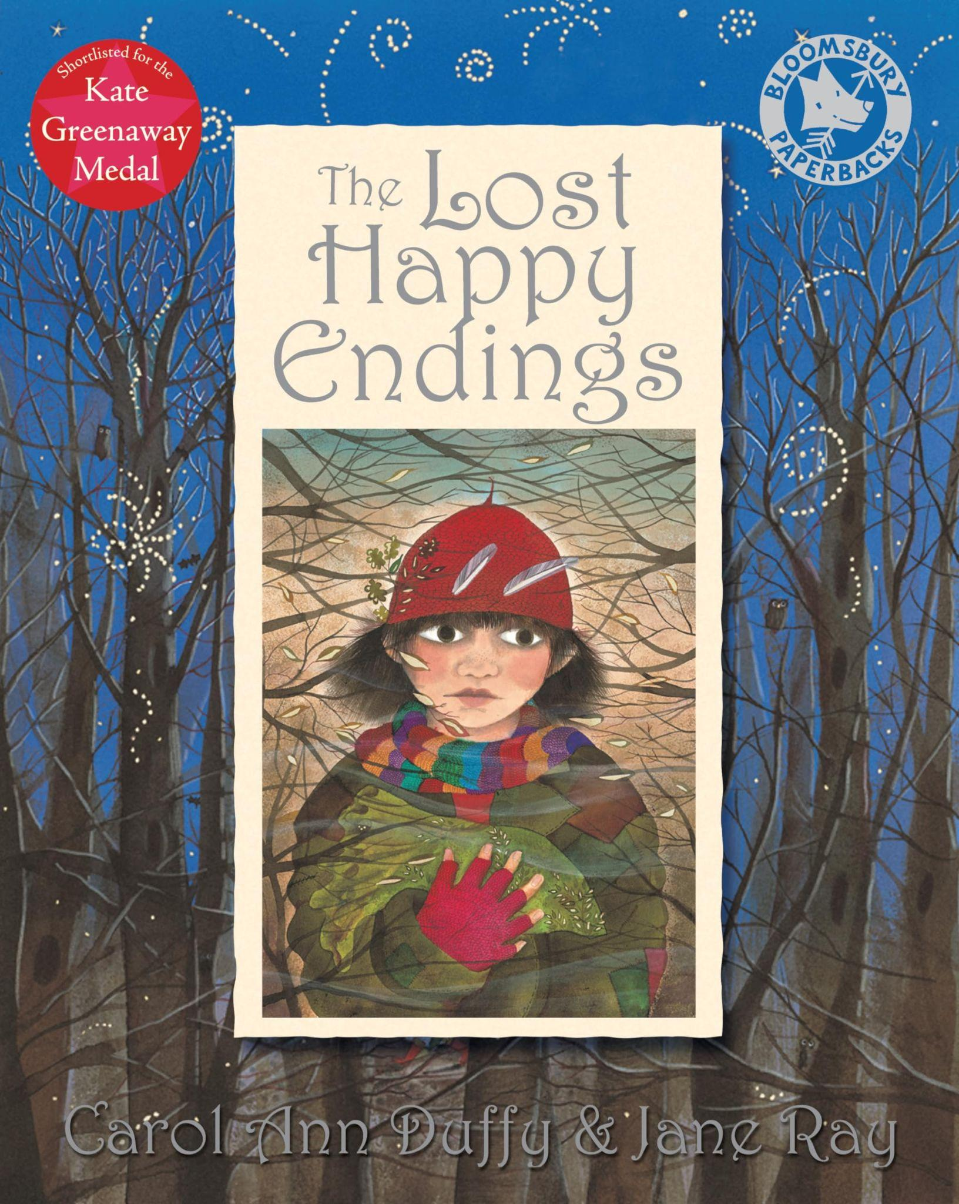


Reading Spine- Autumn 2
You can help by: Encouraging your child to practise spellings, by listening to and encouraging your child to read regularly, reminding them to change their reading book in the mornings, by discussing books read and by visiting the library.

Slide 5
Year 6: Autumn 2026
Year 5: Autumn 1
WRITING
In Autumn 1, we will explore the Tear Thief by Carol Ann Duffy, using the text to develop pupils’ understanding and use of poetic devices. Children will experiment with language, exploring techniques such as similes, metaphors, personification and powerful imagery to make their writing vivid and engaging. They will also develop their understanding of fronted adverbials to vary sentence openings and add detail, as well as using dialogue effectively to reveal character and move a narrative forward.
We will then move on to Amazing Edibles, where pupils will create their own fantastic recipes. They will explore the features of instructional writing, using imperative verbs to give clear and precise commands. Pupils will also learn how to use parenthesis to add extra information and detail, helping them to create engaging and informative recipes.
In Autumn 2, we will explore twisted fairytales, using Neil Gaiman’s version of Hansel and Gretel as our BookWrite. Pupils will investigate how writers create a sense of atmosphere and tension, selecting vocabulary and sentence structures carefully to draw the reader into the story. They will also explore how effective dialogue can reveal character, build suspense and move the story forward. Children will then use these techniques to create their own twisted fairytale-inspired writing.
We will finish the term by writing a newspaper article inspired by a twisted tale. Pupils will explore the features of newspaper writing, including formal language, headlines, reported speech and engaging detail, before creating their own articles based on the events of a twisted fairytale.
Throughout both terms, we teach spelling and grammar daily within our writing lessons. This means children are constantly practising and applying key skills such as using expanded noun phrases, fronted adverbials, varied sentence lengths, and accurate punctuation.

Slide 6


BookWrite
To write a story based on a thief
To write a revoluting recipe

Slide 7

BookWrites- Autumn 2
To create a retelling of a twisted fairytale alongside a newspaper report

Slide 8
Year 6: Autumn 2026
Year 5: Autumn 1
Y6 MATHS
In maths, we will begin the year by focusing on place value, understanding the value of digits in numbers up to ten million. Children will be able to order and compare any number, including negative numbers. Also, they will consolidate their understanding of rounding.
Moving forward from place value, children will develop their understanding of the four operations (addition, subtraction, multiplication and division). They will practise the most efficient method for solving problems- column addition and subtraction; long multiplication and short division
Each child will take part in an additional daily arithmetic session. These sessions will focus on the four operations and include questions which focus on decimals and fractions.
You can help by: Revisiting times tables with your child daily, ensuring that they have instant recall up to 12 x 12 and can make links with multiples. eg. 7 x 8 = 56 so 70 x 8 = 560

Slide 9
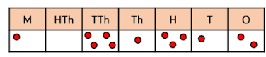
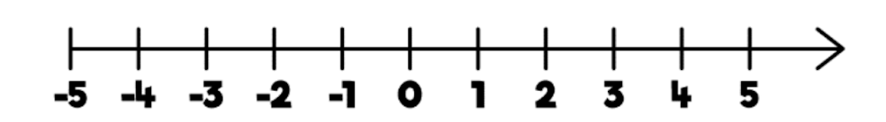
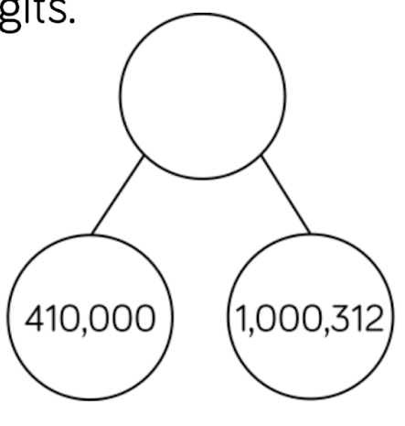
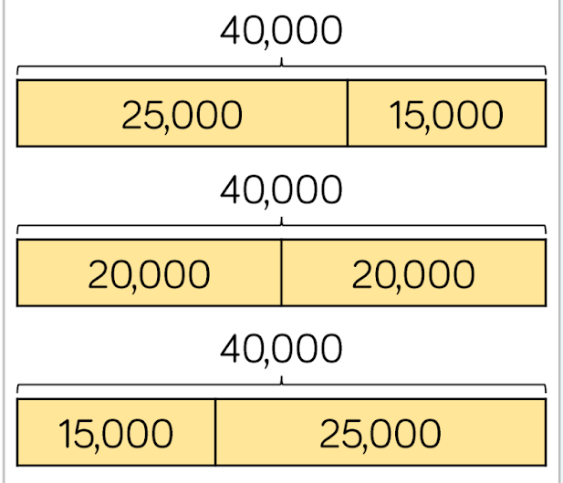
Y6: Maths- models and images
Place Value Chart
Place Value
Understand the value of numbers up to ten million
Compare and order any number (including negative numbers)
Round any number up to ten million
Number line (including negative numbers)
Part Whole Model
Bar Model

Slide 10
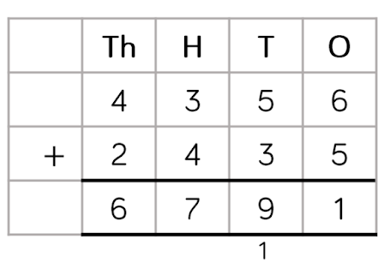
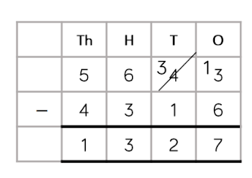
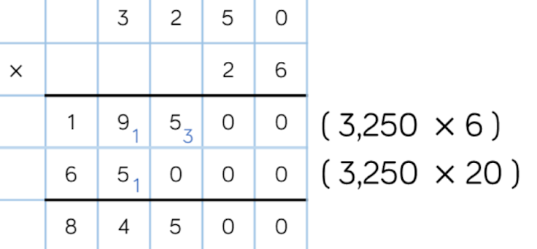
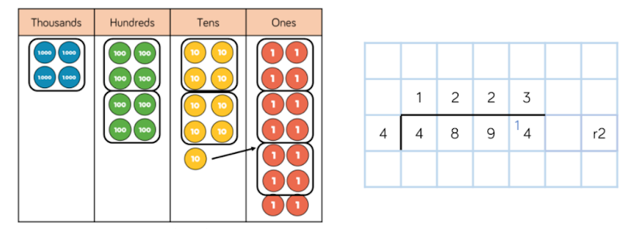
Y6: Maths- models and images
Column Addition (with place value chart support)
Four Operations
Add and subtract integers.
Multiply a 4 digit number by a 2 digit number.
Use short division to divide four digit numbers by 1 and 2 digit numbers.
Column Subtraction (with place value chart support)
Long Multiplication
Short Division

Slide 11
Year 6: Autumn 2026
Year 5: Autumn 1
History: The Romans (Autumn 1)
In History this term, we are exploring how Ancient Rome grew into a vast and powerful empire. The children will investigate key trends that shaped Roman life, including the shift in political power, the evolution of religion, and the impact of rapid empire expansion. Through these big-picture themes, pupils will discover how the Roman legacy still influences our world today.
You can help by: researching the Romans and talking through the myths and legends.
Science:
Autumn 1: Separating mixtures
We will be starting the year by learning the difference between mixtures and pure substances, reversible and irreversible changes and the techniques that can be used to separate mixtures.
You can help by: talking about the different types of mixtures we use in everyday life- sugar in tea!
Autumn 2: Forces
We will be exploring the invisible pushes and pulls that control how things move, fall, float, and stop in the world around us. Through hands-on experiments, your child will be discovering gravity, friction and resistance
You can help by: asking them to spot forces in action, whether it's the grip on their shoes, riding a bike, or using a pair of scissors!
Geography: Climate Across the World (Autumn 2)
This term, children will explore the different climate zones around the world, learning how weather patterns vary across continents and how climate affects the way people live. We will look at key features of tropical, temperate, arid, and polar climates, using maps and case studies to deepen understanding.
You can help by: exploring maps of the world.
RE:
Autumn 1: How are Hindu beliefs expressed in artefacts and worship?
Autumn 2: How does sacred text help Hindus understand Dharma?

Slide 12
Year 6: Autumn 2026
Year 5: Autumn 1
PE
Indoor:
Autumn 1: Dance
Autumn 2: Fitness
Outdoor:
Autumn 1: Tag Rugby
Autumn 2: Netball
DT: Textiles (Autumn 2)
Children will investigate, analyse and evaluate a range of existing products which have been produced by combining fabric shapes. They then design, make and evaluate a product, developing skills of threading needles and joining textiles using a range of stitches. Children investigate how to sew and shape curved edges by snipping seams, tack or attach wading and how to start and finish off a row of stitches. Children learn how to use and how to pin a pattern on to a fabric ensuring limited wastage and how to leave a seam allowance.
PSHE:
Autumn 1: Happiness, Positivity and Feeling Special
Autumn 2: Emotions, Feelings and Friends
Music: Peter and the Wolf
This term, children will learn to compose music using Chrome Music Lab. They will learn about major and minor tonality and be able to recognise these within their compositions.
Computing: TinkerCAD
We will be using TinkerCAD to plan a project. Using technology makes it easier to plan a project because it is easy to edit and undo using the software tools.
Art: Illustrations (Autumn 1)
In art this term, we are stepping into the shoes of visual storytellers to explore illustrative art and storyboarding. The children will examine how artists use dynamic images, framing, and sequence to bring narratives to life without using words alone. Drawing inspiration from our history topic, each pupil will plot and design their own original story set in Ancient Rome.
French:
Autumn 1: Clothes
Autumn 2: At the Cafe

Slide 13
Home Learning
Year 5: Autumn 1
Reading
In Year 5 and 6, children should be reading at least 4 times per week for 15-20 minutes. Children should record their reading journey in their reading record. Please encourage your child to read as frequently as possible at home.
Spellings
Spellings will be sent home every Friday and tested the following week. Children should practise their spellings using Spelling Shed. It is recommended that they play at least three games on Spelling Shed per week.
Maths
Children should use Times Tables Rock Stars to ensure they have a rapid recall of all multiplication and division facts up to 12x12. We recommend children practise at home at least four times a week for 15-20 mins. Weekly homework will be set each week which children can use to consolidate the learning.
Grammar (Y6 only)
At the end of Year 6, children will sit a GPS test (grammar, punctuation and spelling). To prepare them for this, weekly homework will be sent out on a Friday. This will need to be completed by the following Friday.

Slide 14
Behaviour
Year 5: Autumn 1
We continue to work across the curriculum to develop cooperative learning and social skills. Pupils are encouraged to discuss matters relevant to them, their behaviour and their relationships with others. The school takes a trauma-informed approach to managing behaviour.
The school operates a Positive Behaviour Policy. Rewards take the form of verbal praise, House points, certificates and ‘marbles-in-the-jar’ for effort and attainment across the whole range of school activity, linked to Oldway’s values. Certificates are presented to the children in Celebration Assembly on Friday mornings and when the marble jar is full, the class is entitled to a class treat - enjoyed by all. Additional certificates are awarded for good behaviour and cooperative play at lunch times. Children who continuously make the right choices will be nominated for a ‘Hot Chocolate with the Head,’ and others may receive a ‘Golden Phonecall.’
Consequences vary according to the seriousness of the incident and/or behaviour. On occasion, children are required to finish class activities at playtime or at home if lesson time has been missed by poor behaviour in class. Missed break time or lunchtime operates as a sanction when things go ‘more wrong’. During this time, children will be able to reflect on how to improve their behaviour and decide ‘how to make things right’. When poor or inappropriate behaviour is persistent, parents are contacted and are asked to discuss concerns with either Mrs Fox (Assistant Head), Miss Eva Rowe (Family Support Worker), Mrs Laura Bateman (SENCO), Mr Chris Hallett (Deputy Headteacher) or Mrs Emma Bamber (Headteacher).
When there are questions or concerns, your first point of contact should be the class teacher who knows your child best. In addition, Mrs Fox (Assistant Head) is also available to give help and assistance.

Slide 15
Staff
Year 5: Autumn 1
Y5/6 Teachers
Mrs H Fox (St Mary’s Bay and AHT)
Mrs S Scott (Berry Head)
Mrs Peters / Mr N Harman (Fishcombe Cove)
Mr Dale (Elberry Cove)
Mrs Atkins (Churston Cove)
Mrs Derby (Shoalstone Beach)
Miss Bolton (Maidencombe Beach)
Y5/6 TAs
Miss L Lewis (HTLA)
Mrs J Hiscoke (Reading Champion)
Mrs K Carter (Pastoral Team)
Mrs A Butterworth (FreshStart Champion)
Mrs A Babat (Maidencombe Beach)
Mrs Sweaney (Maidencombe Beach)
Mrs Morris (Maidencombe Beach)

